Slide 1
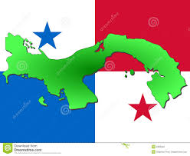
Service Above Self
Joint RD 6080 and 4240 and
Fundación Pro Niño's de Darién
Panama Water Project - 2017
RF Global Grant
and beyond…

Slide 2
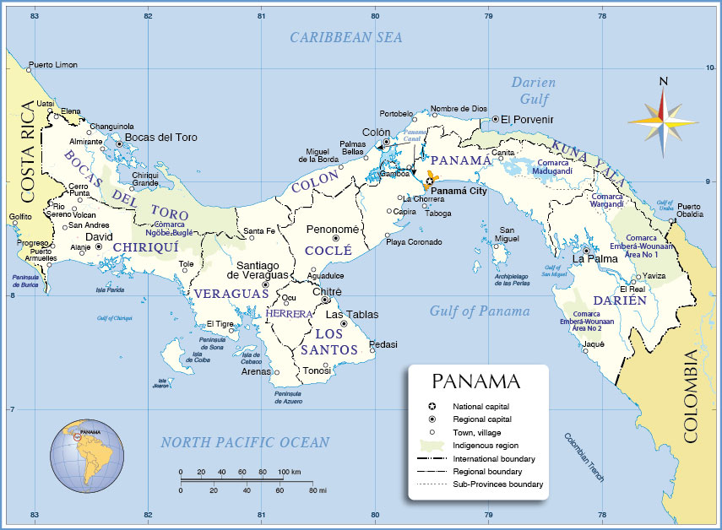
Notes:
This slide acquaints the viewer with the Republic of Panama and the general location of Darien Provence with respect to the country as a whole and the fact that it borders on Columbia.
It also illustrates the fact that BSF units were distributed to all across Panama. Upcoming slides show examples.

Slide 3
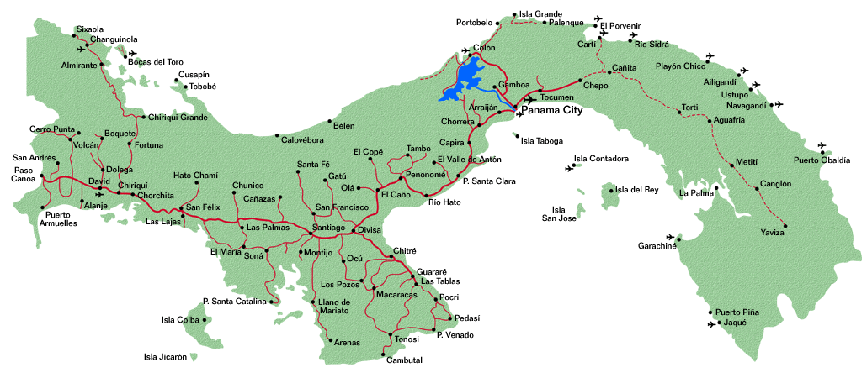
Caribbean Sea
Panama
Pacific Ocean
Notes:
This slide shows the location of Darien Provence.

Slide 4
The Fundación Pro Niño's de Darien (FPND) is a non-profit organization in Darien Provence, Panama, whose primary mission is to reduce child malnutrition through interrelated activities: nutrition, health, education, early childhood development, farming production and community development.
The lack of clean, potable water in schools, nutrition sites, and communities-at-large, requires nearly all residents to drink untreated water obtained directly from a near-by river.
Notes:
This slide introduces the Foundation for the Children of Darien, its mission, and why a water filtration project is Darien is important.

Slide 5
The Fundación Pro Niños de Darién (FPND) has identified 26 communities in Darien as points of focus for the Panamanian Water Project (PWP).
These communities are designated as nutrition sites and there is a school present at each site with a combined school population of about 1800.
These 26 communities have a total population of 7200, hence, 7200 secondary beneficiaries.
Notes:
This slide shows some specifics of the PWP 2016. The slide illustrates that a large number of people are to be impacted by the project.

Slide 6
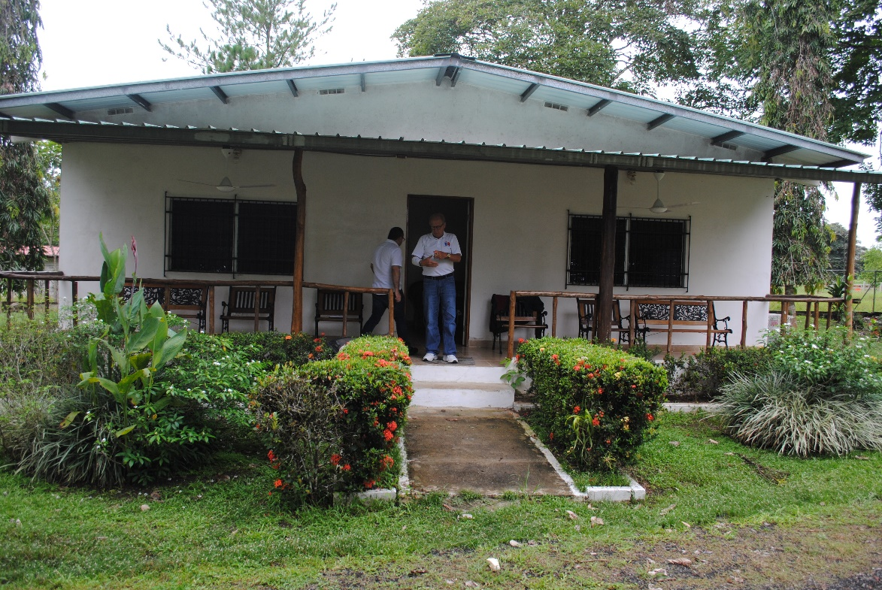
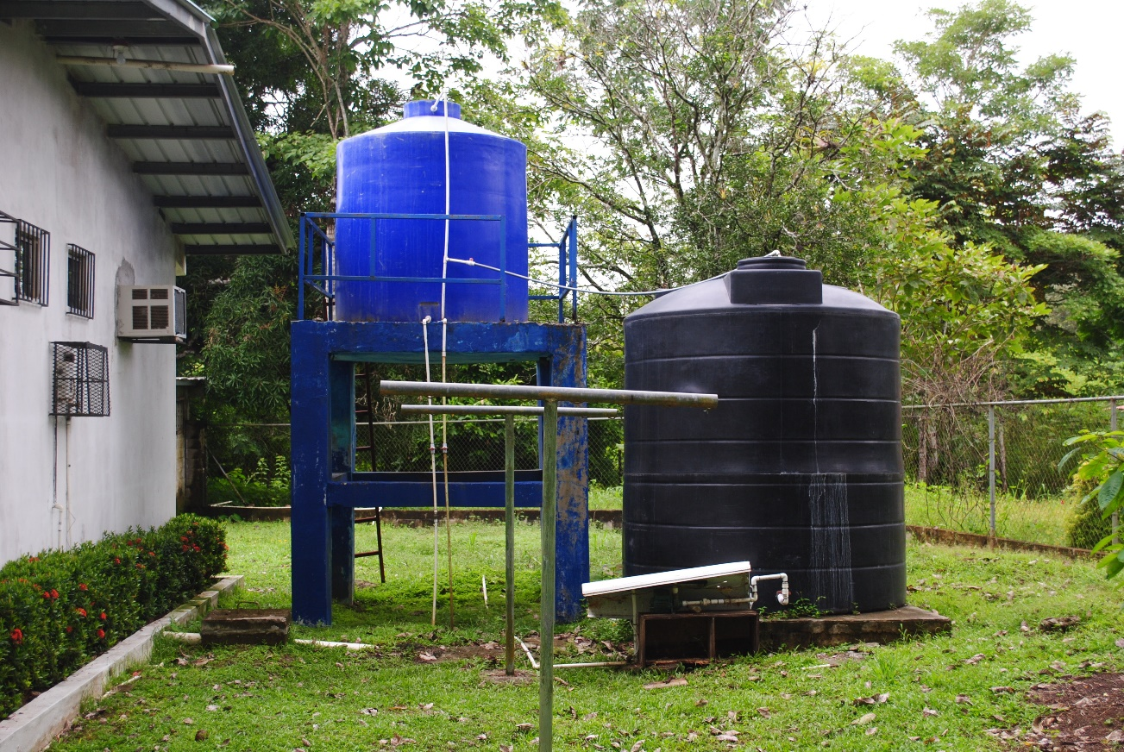
Fundación Facility Near Meteti
Dormitory
Rain Water Storage

Slide 7
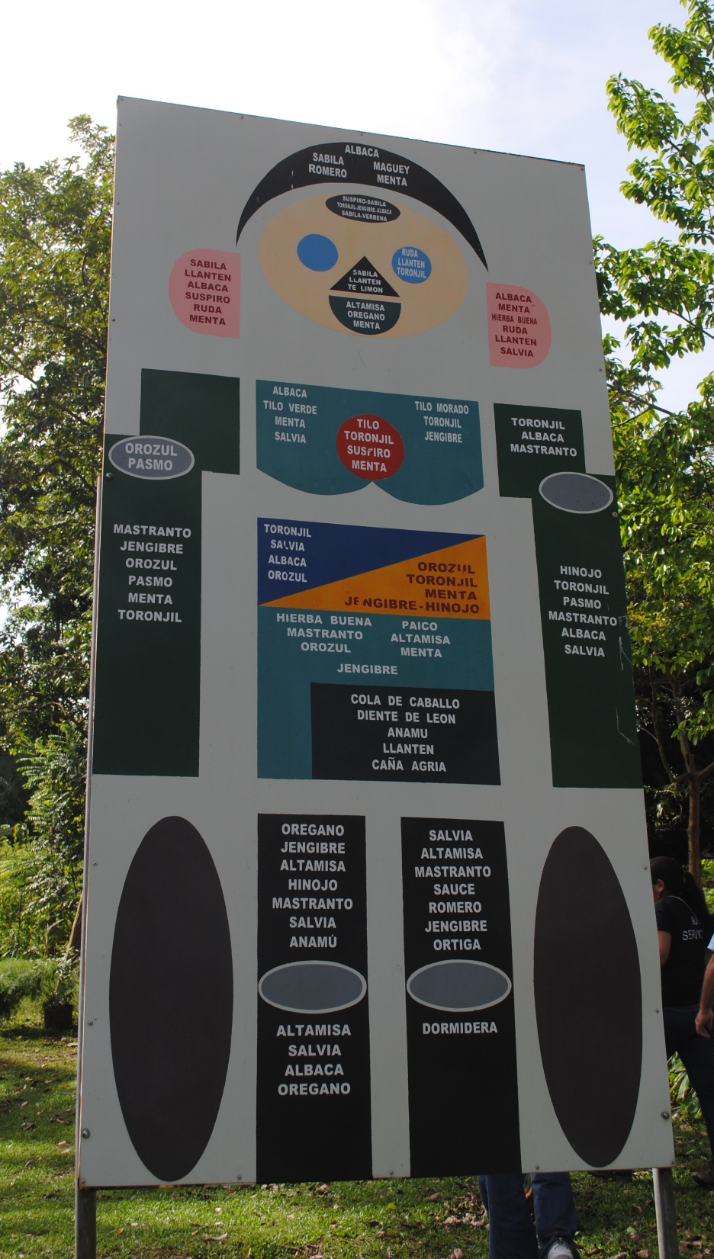
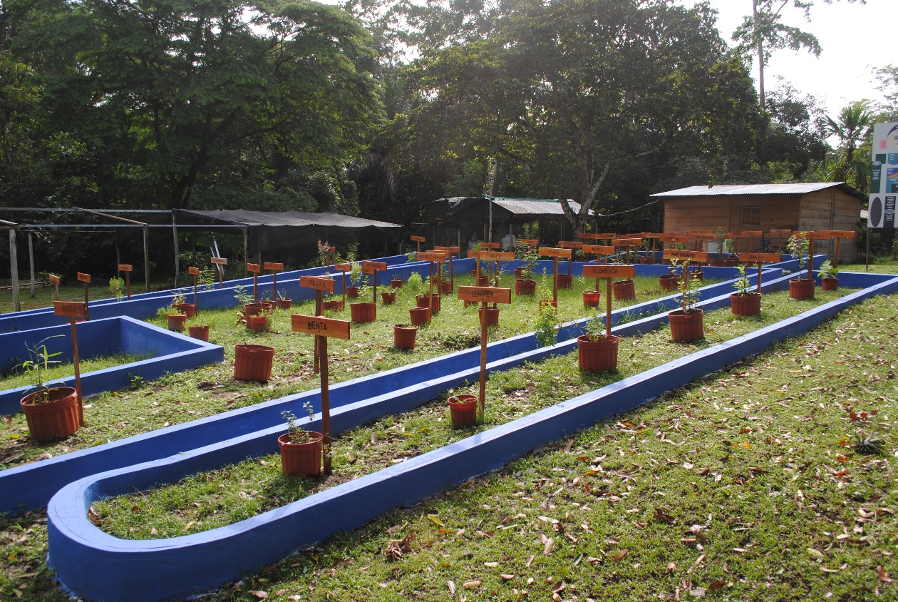
Educational and Training Garden
at Fundación Facility near Meteti

Slide 8
Morti (25)
Zimba
17-18
19-24
2,4-7,9
12-16
1,3,8,10,11,26
Sambu River
Approximate location of 26 Darien
Schools and Communities
Notes:
This slide shows the location of the 26 nutrition sites involved in the PWP 2016.

Slide 9
Meteti
Alto Playona
Approximate location of Alto Playona w.r.t.
Meteti

Slide 10
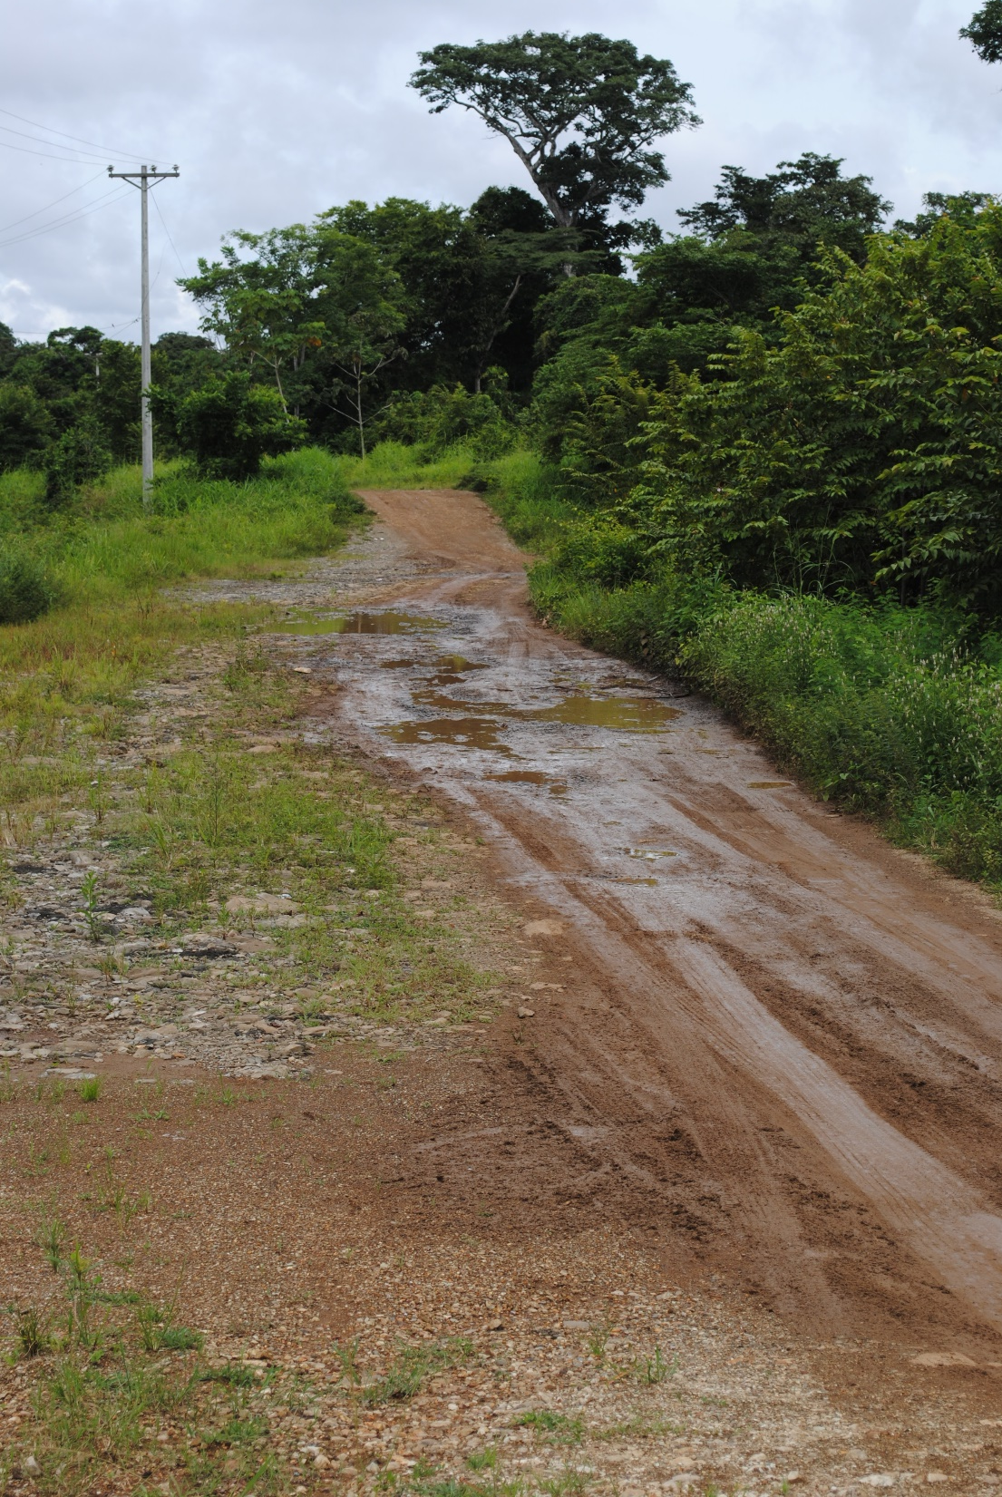
Road to the
Chucunaque
River

Slide 11
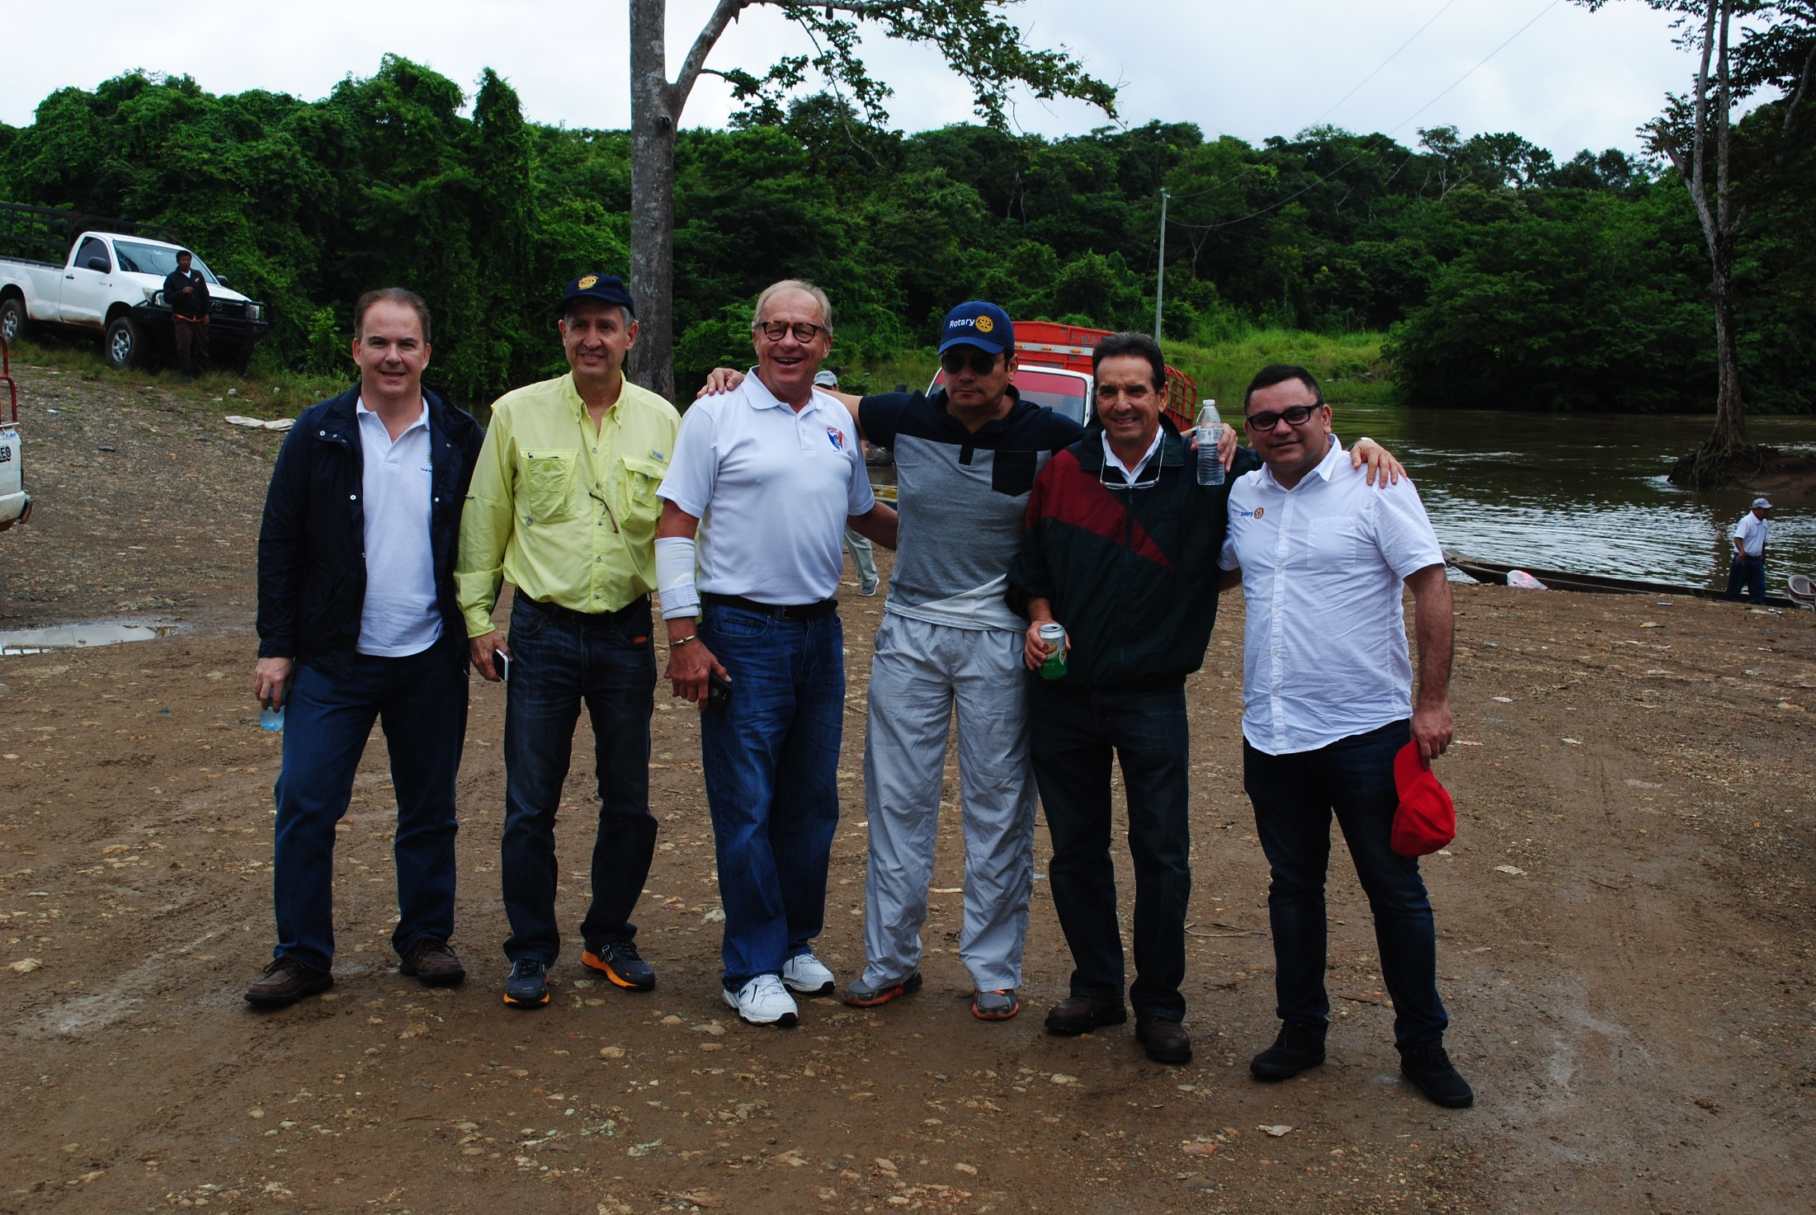
Team Panama at the Rio Chucunaque
Notes:
Vicente, Hosea, Jim, Raul, Ramon, Manuel

Slide 12
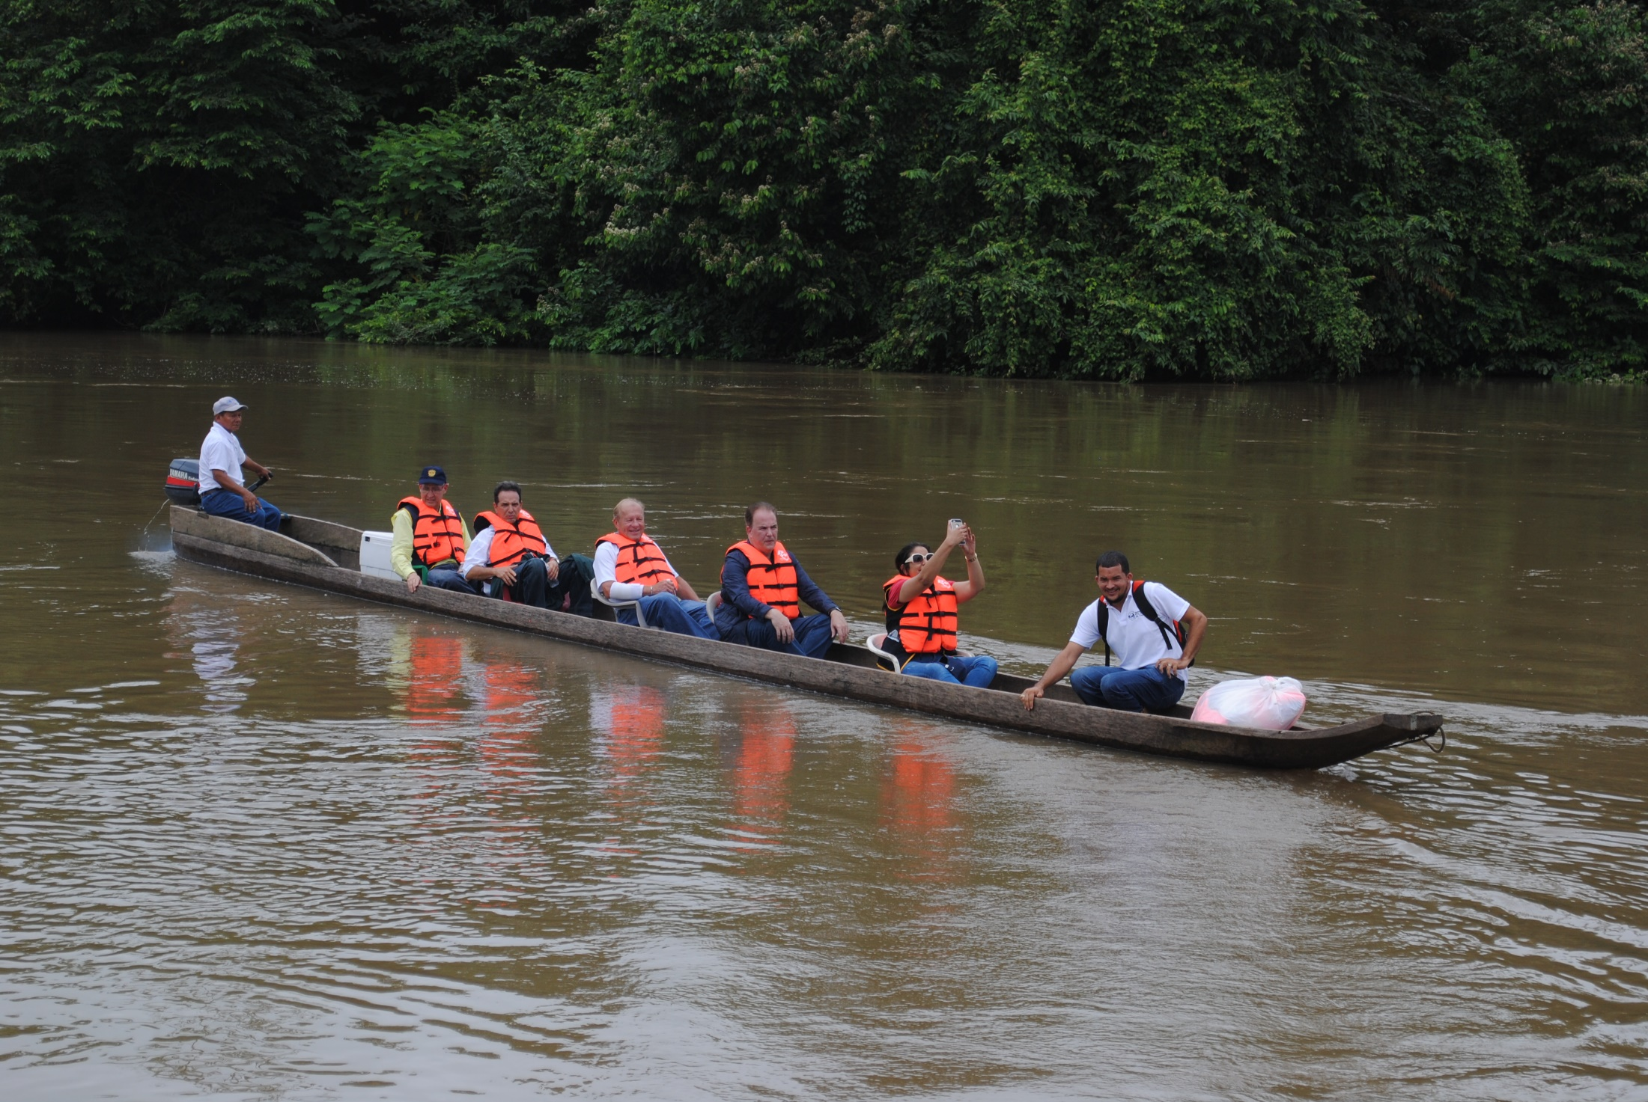
River Transportation on the Rio Chucunaque

Slide 13
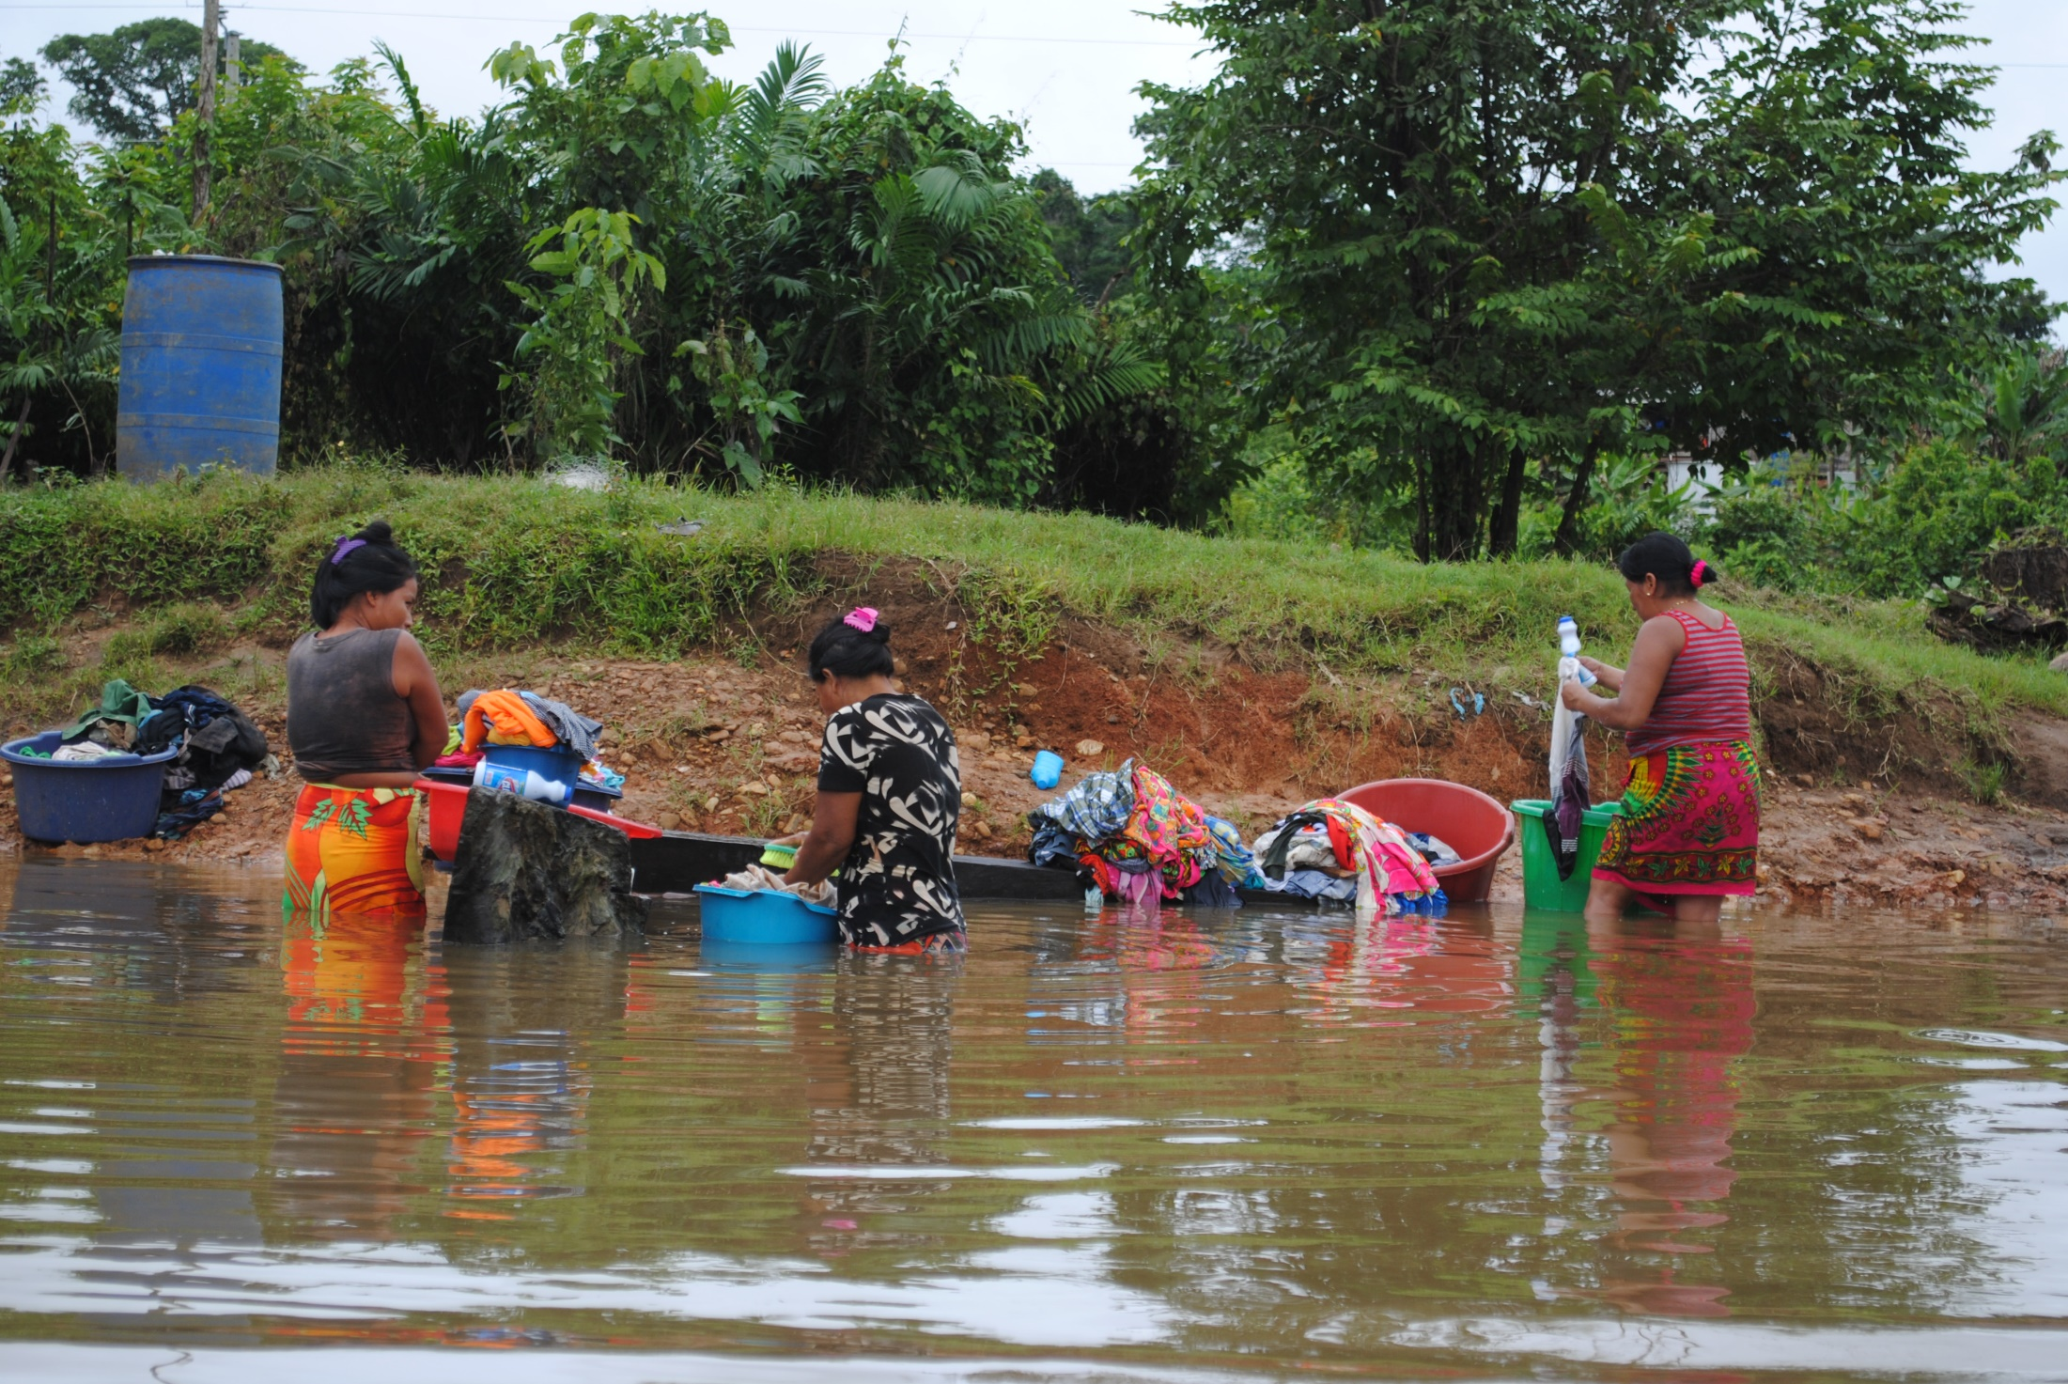
Wash Day at Alto Playona

Slide 14
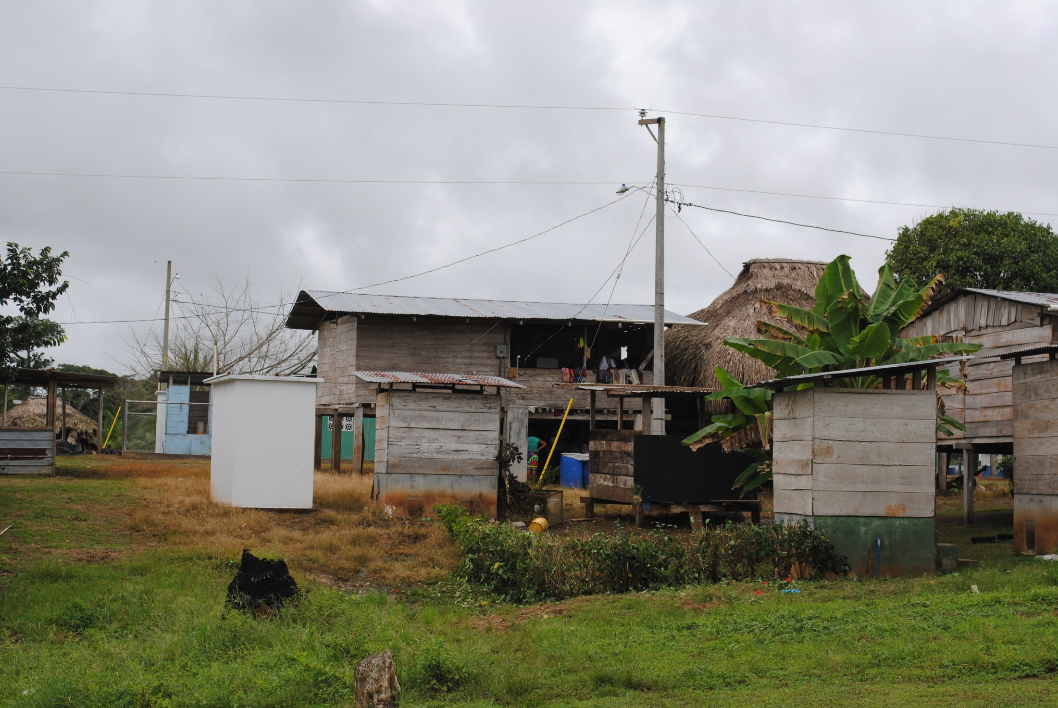
The new and the old at Alto Playona

Slide 15
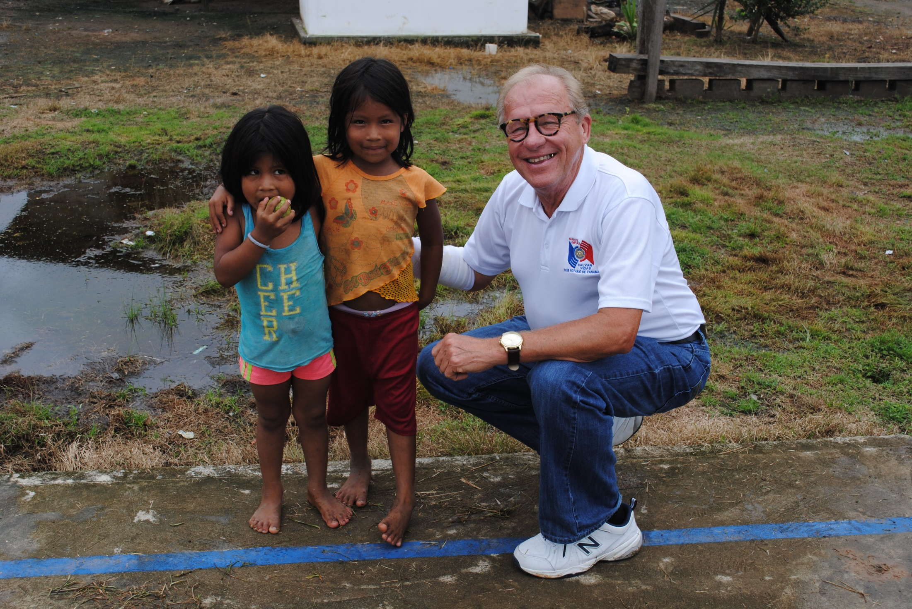
Jim Wieberg
greets Alto
Playona children

Slide 16
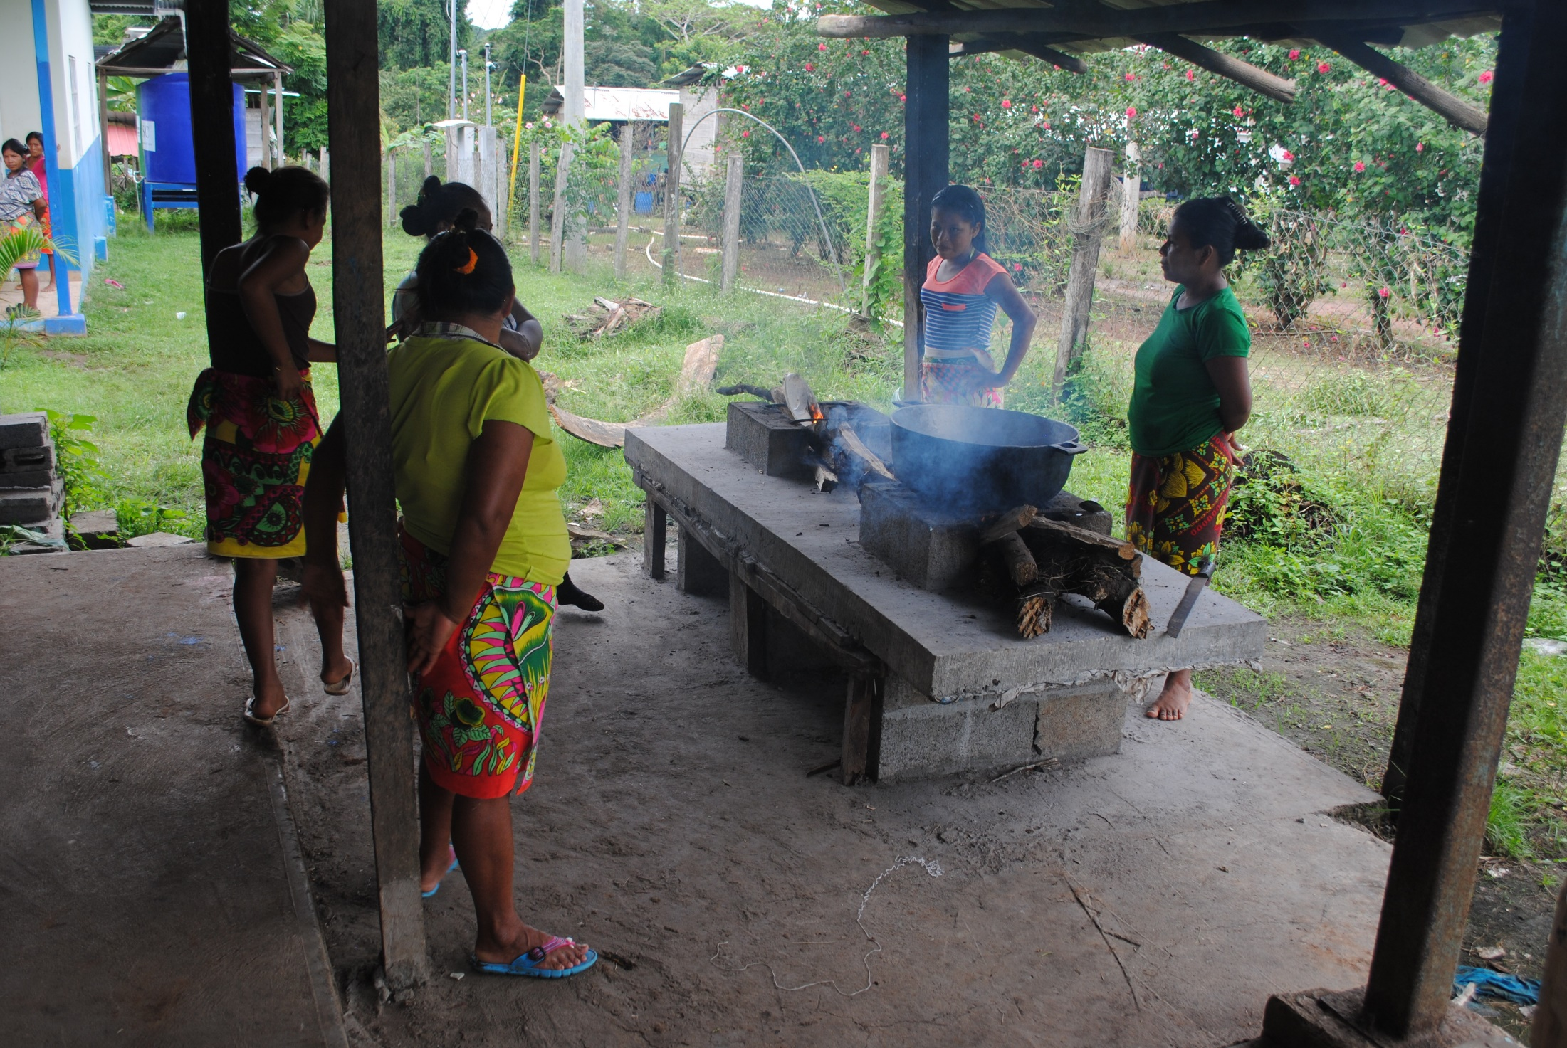
Lunch preparation
at Alto Playona

Slide 17
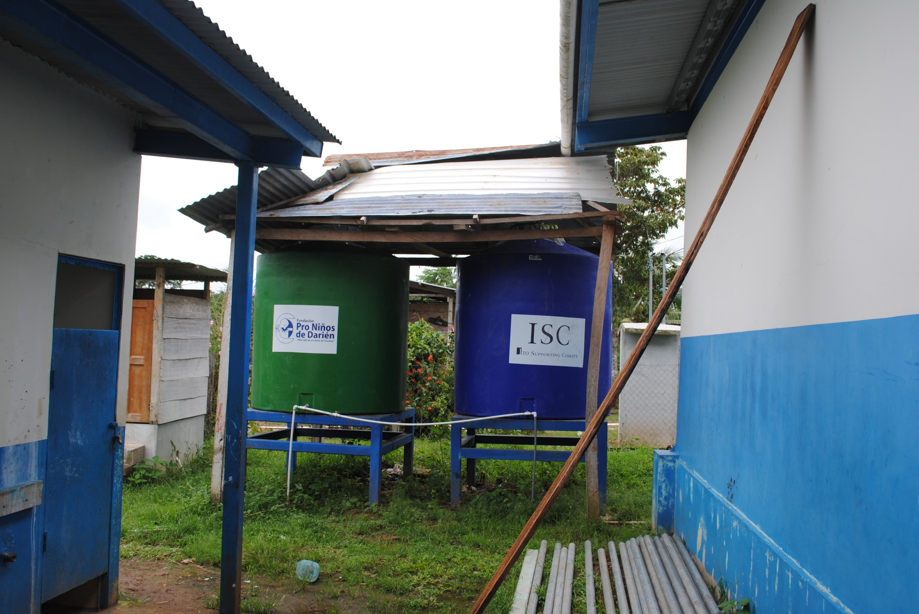
Rain Water Storage
at Alto Playona

Slide 18
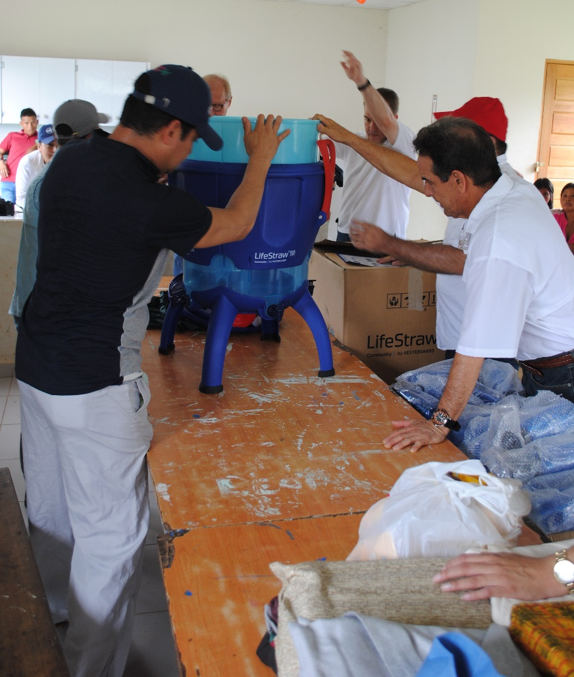
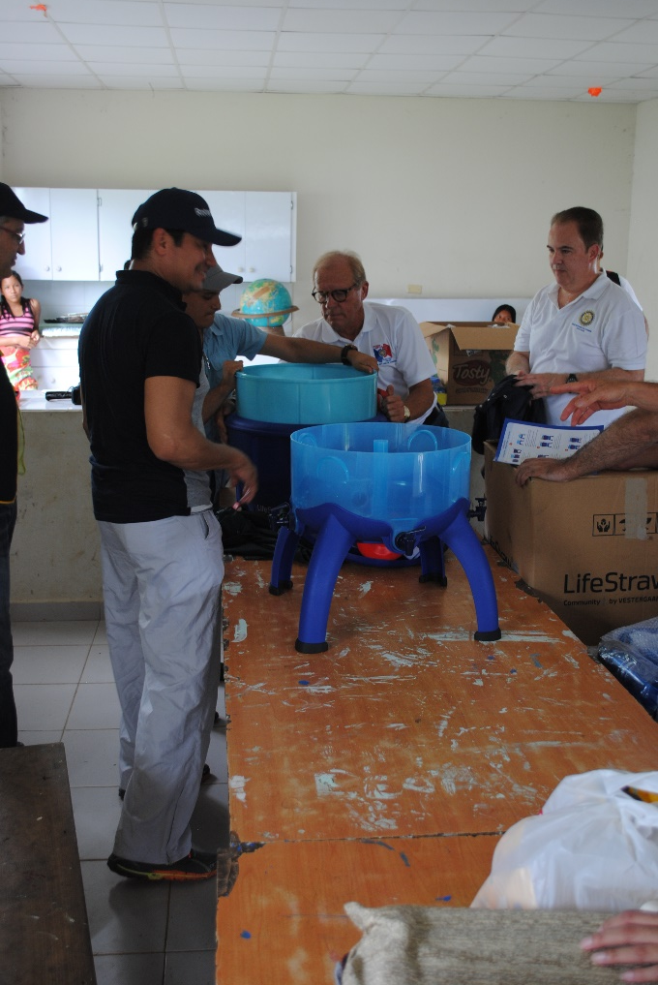
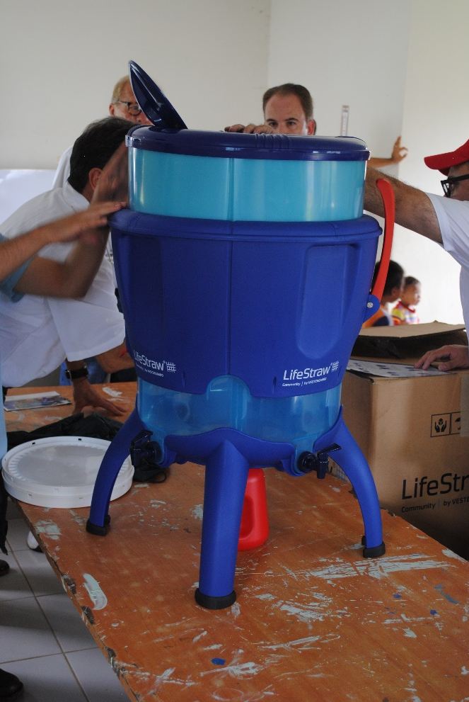
LifeStraw Community
Filtration Unit (LCFU)
assembly at Alto Playona

Slide 19
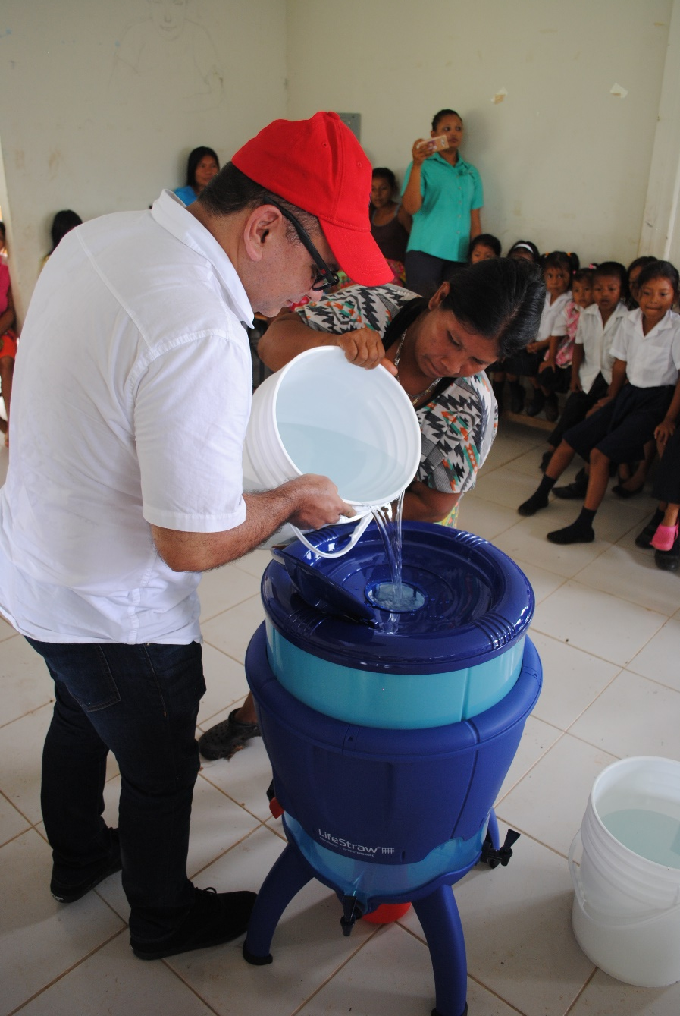
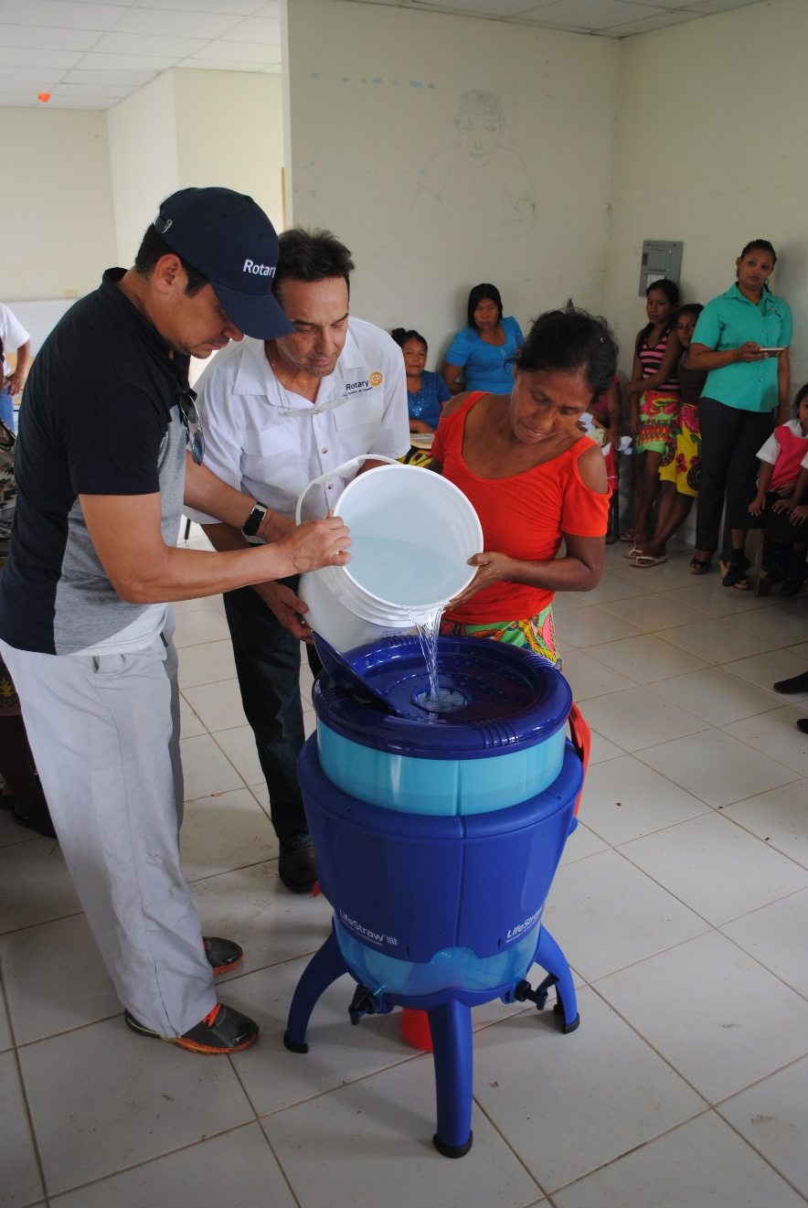
Filling Filters
at Alto Playona

Slide 20
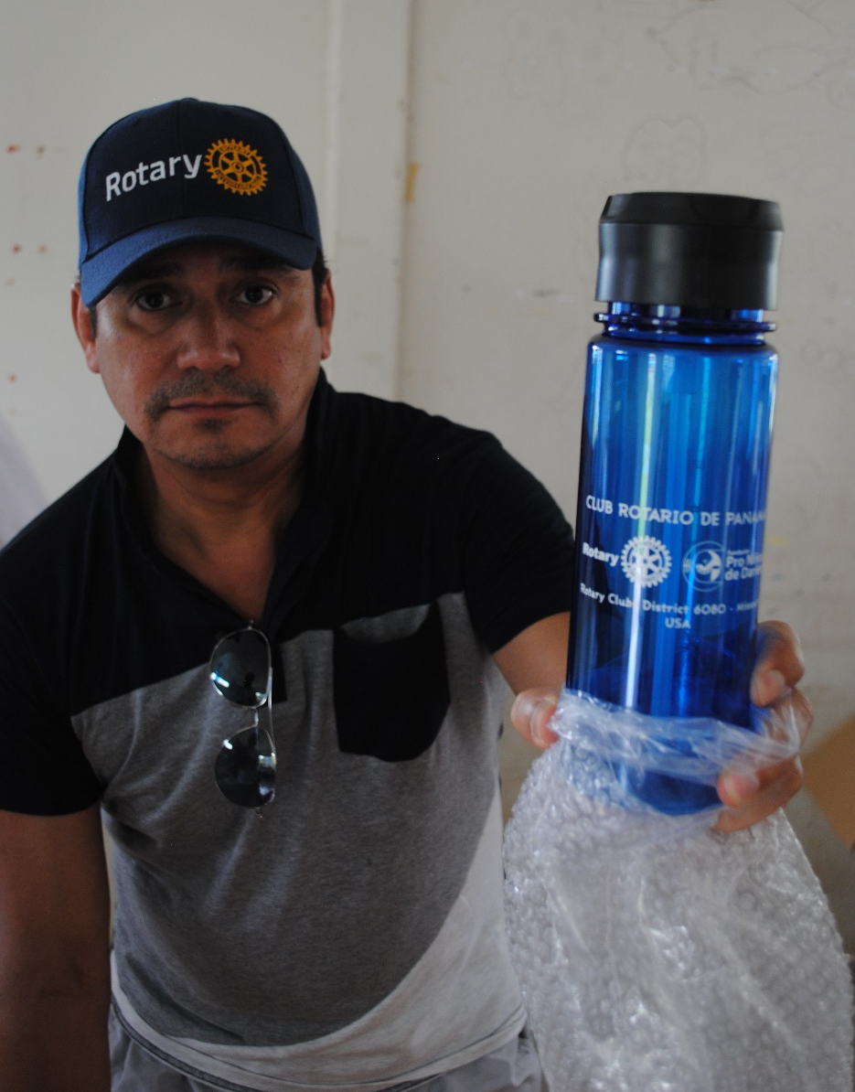
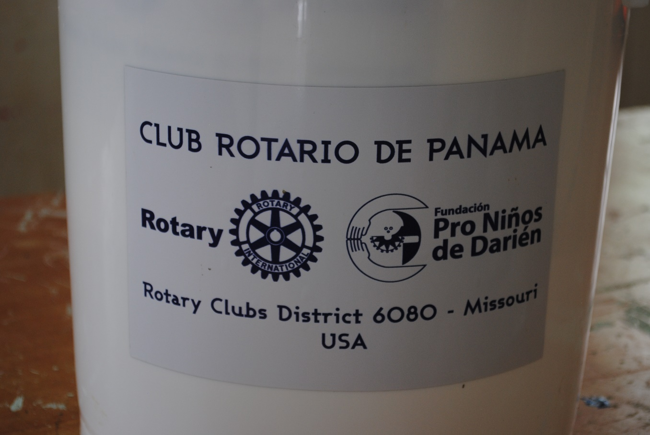
Personal Water Bottle with Rotary and FPND Logos
Five gallon collection
bucket with Rotary and Fundación Logos

Slide 21
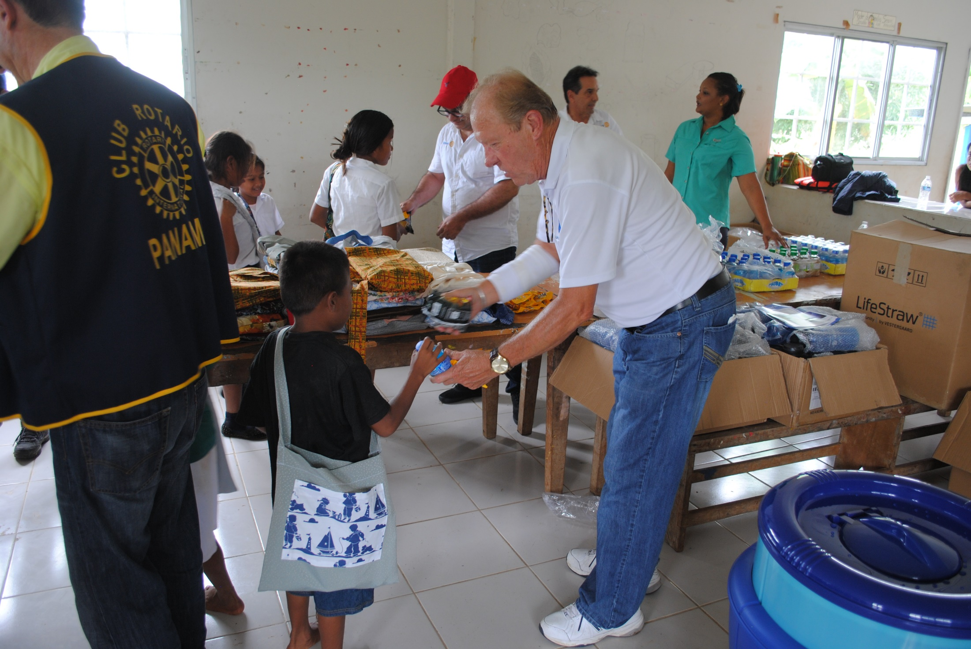
Distribution of book bags, sodas, chips and M&M’s
at Alto Playona

Slide 22
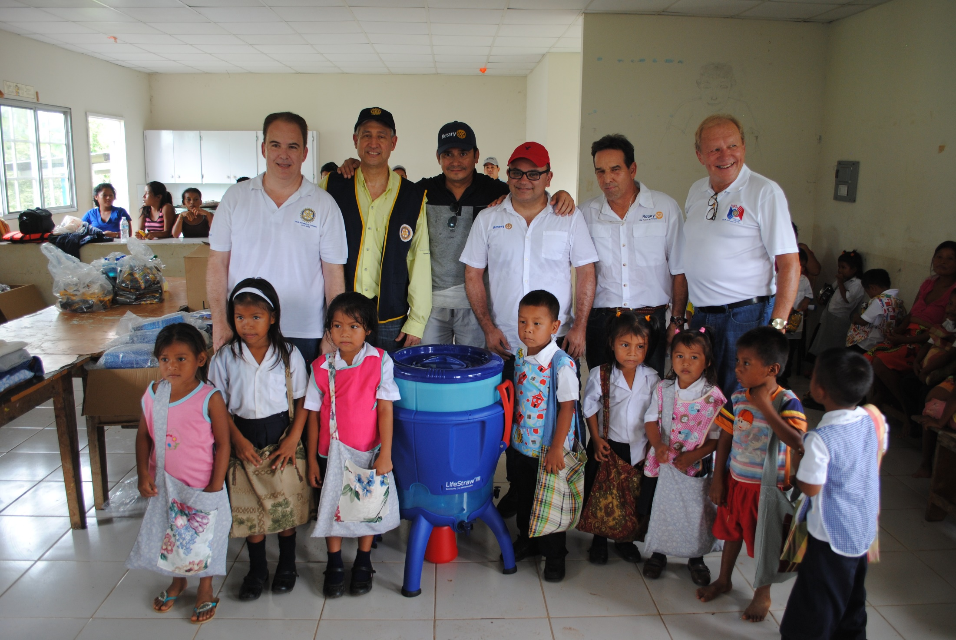
Team Panama with school children of Alto Playona

Slide 23
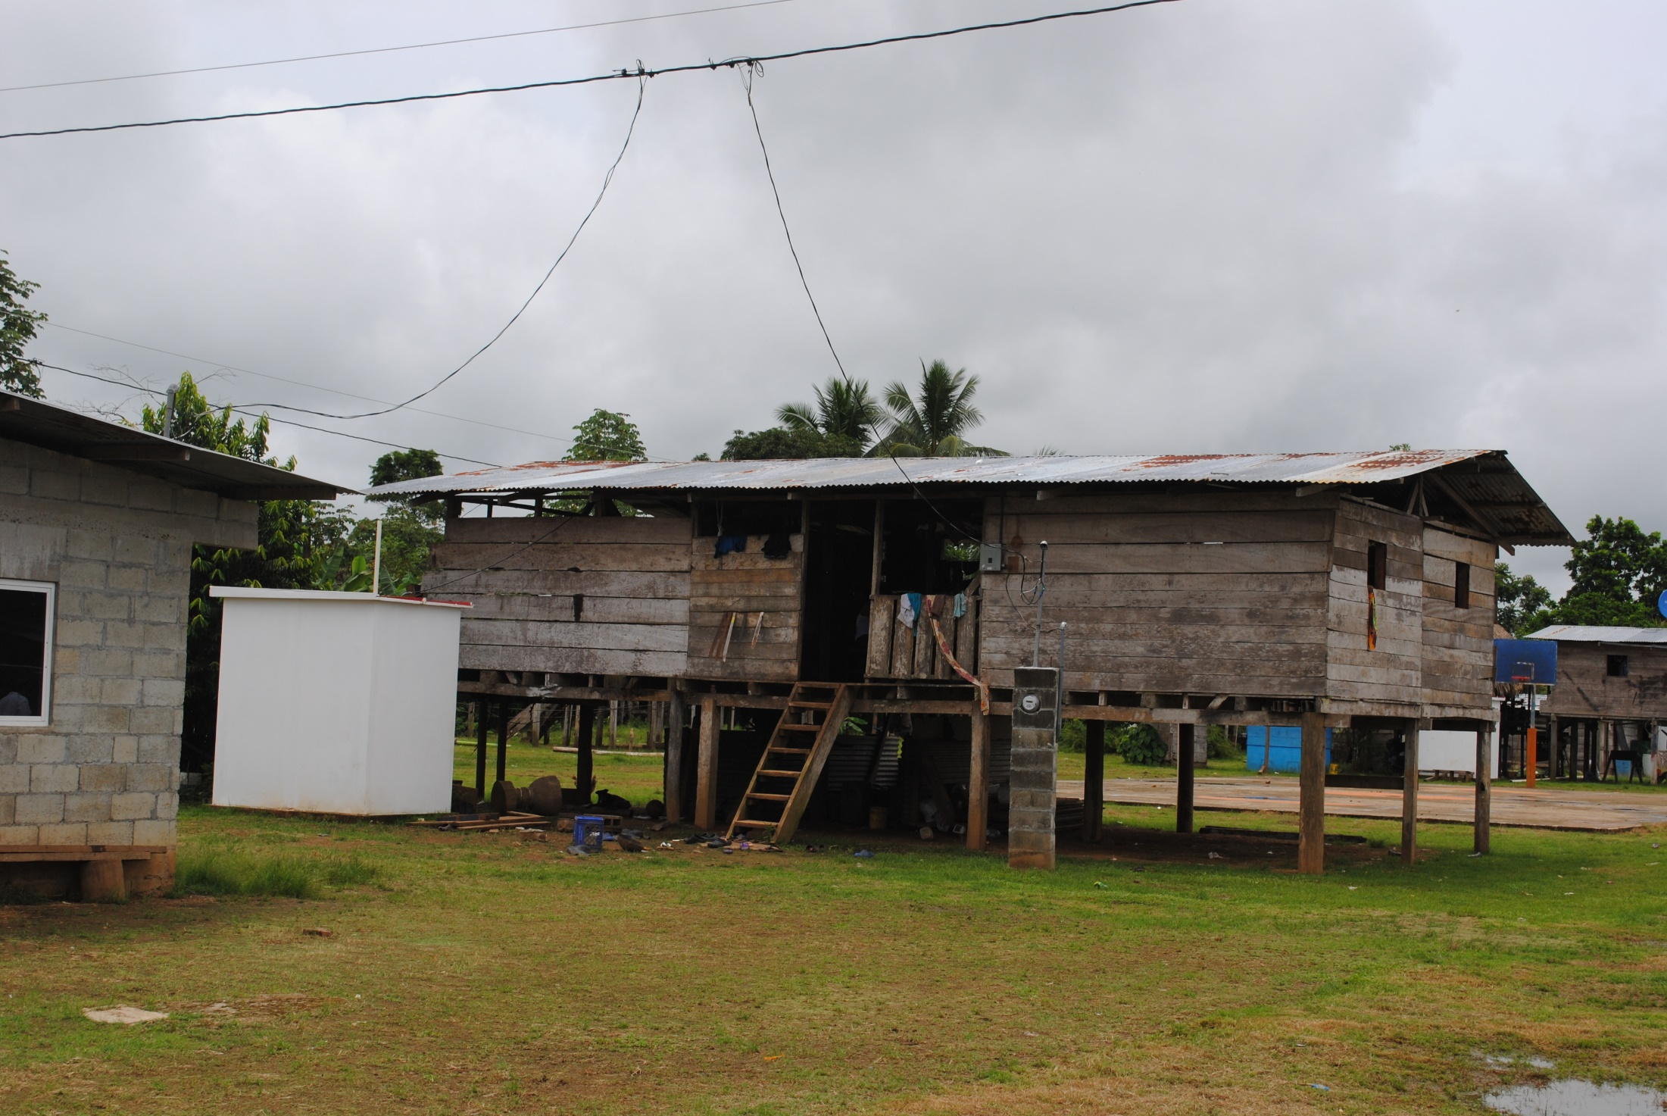
The old and new at Alto Playona

Slide 24
Palmira
Meteti
Approximate location of Plamira w.r.t.
Meteti
Notes:
This slide shows the location of one of the 26 nutrition sites involved in the PWP 2016 and the fact that it is accessed via the Sambu River.

Slide 25
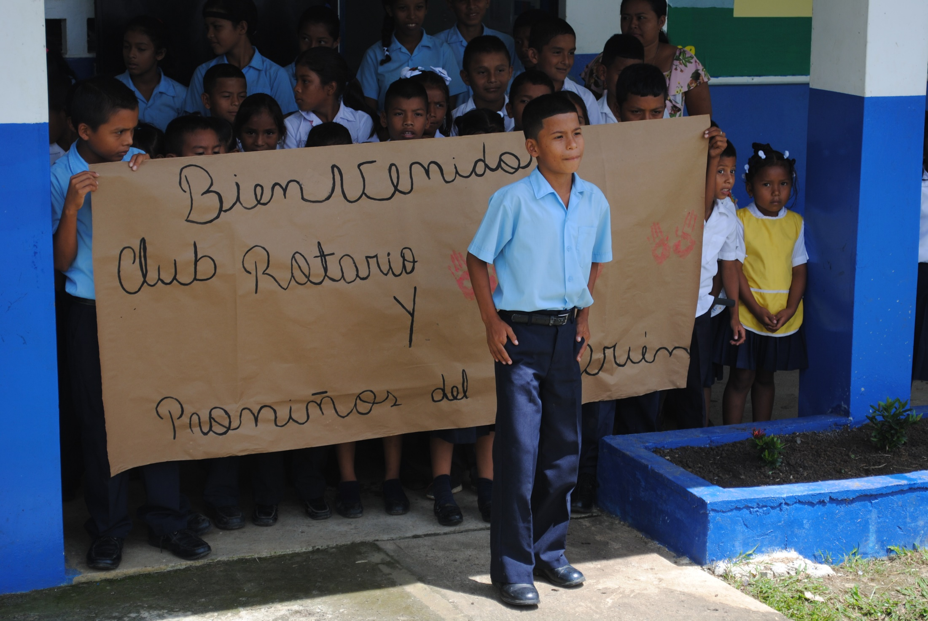
Students welcome Team
Panama to Palmira

Slide 26
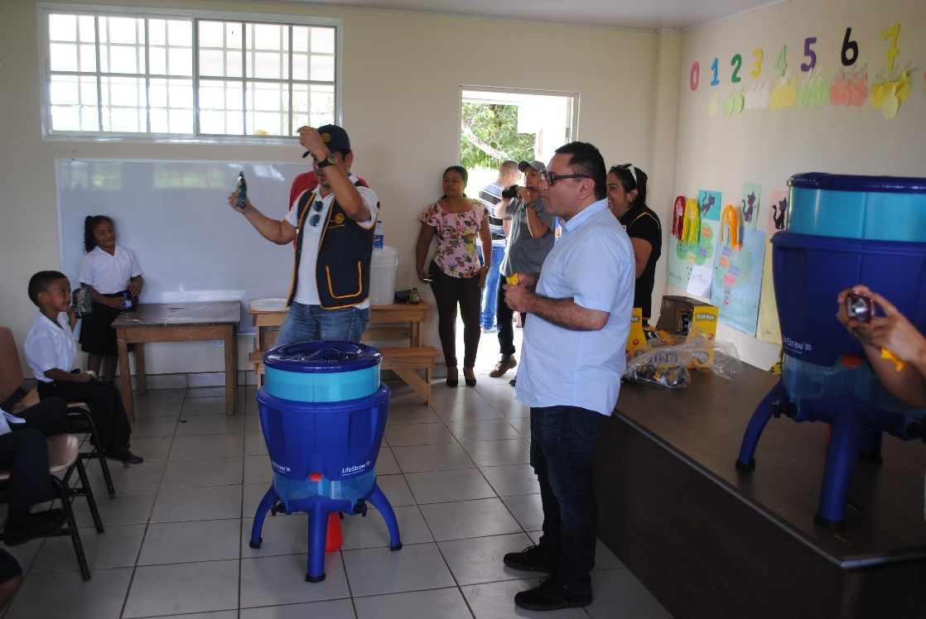
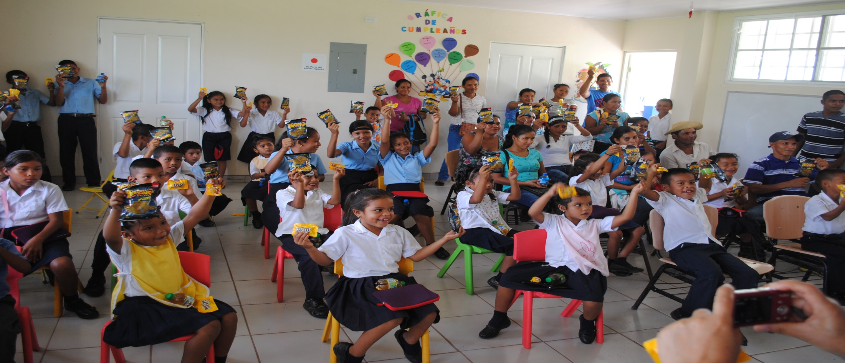
LCFU Assembly and Training at Palmira School

Slide 27
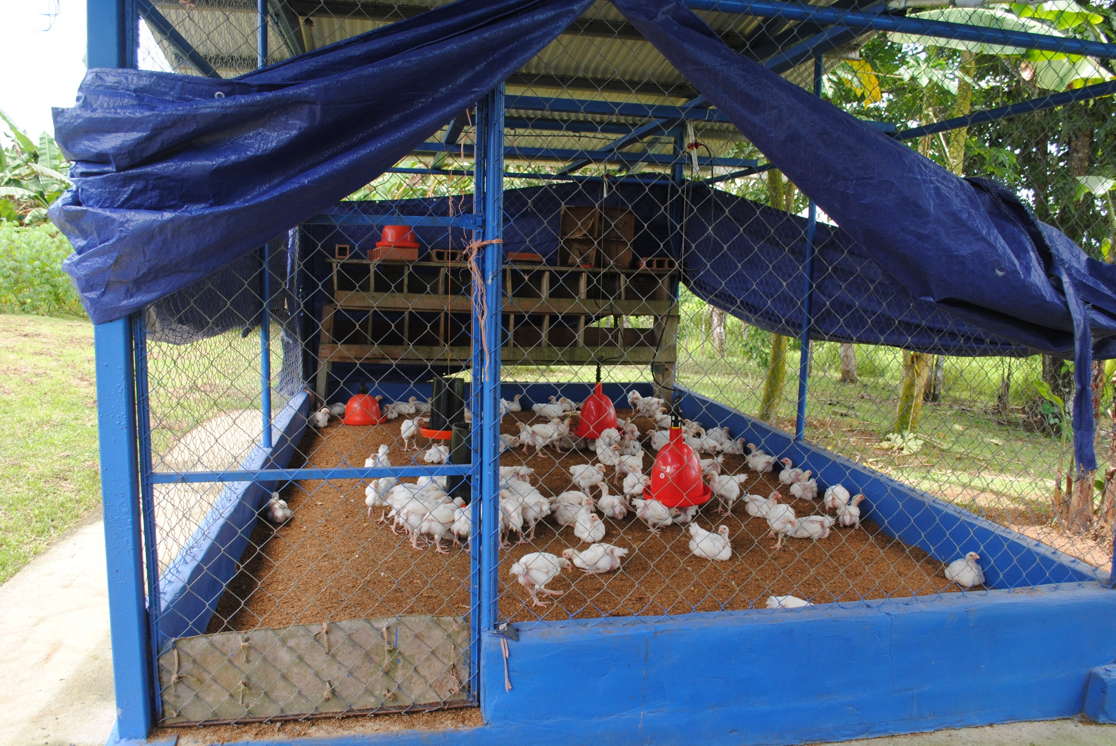
Agriculture in Palmira Community

Slide 28
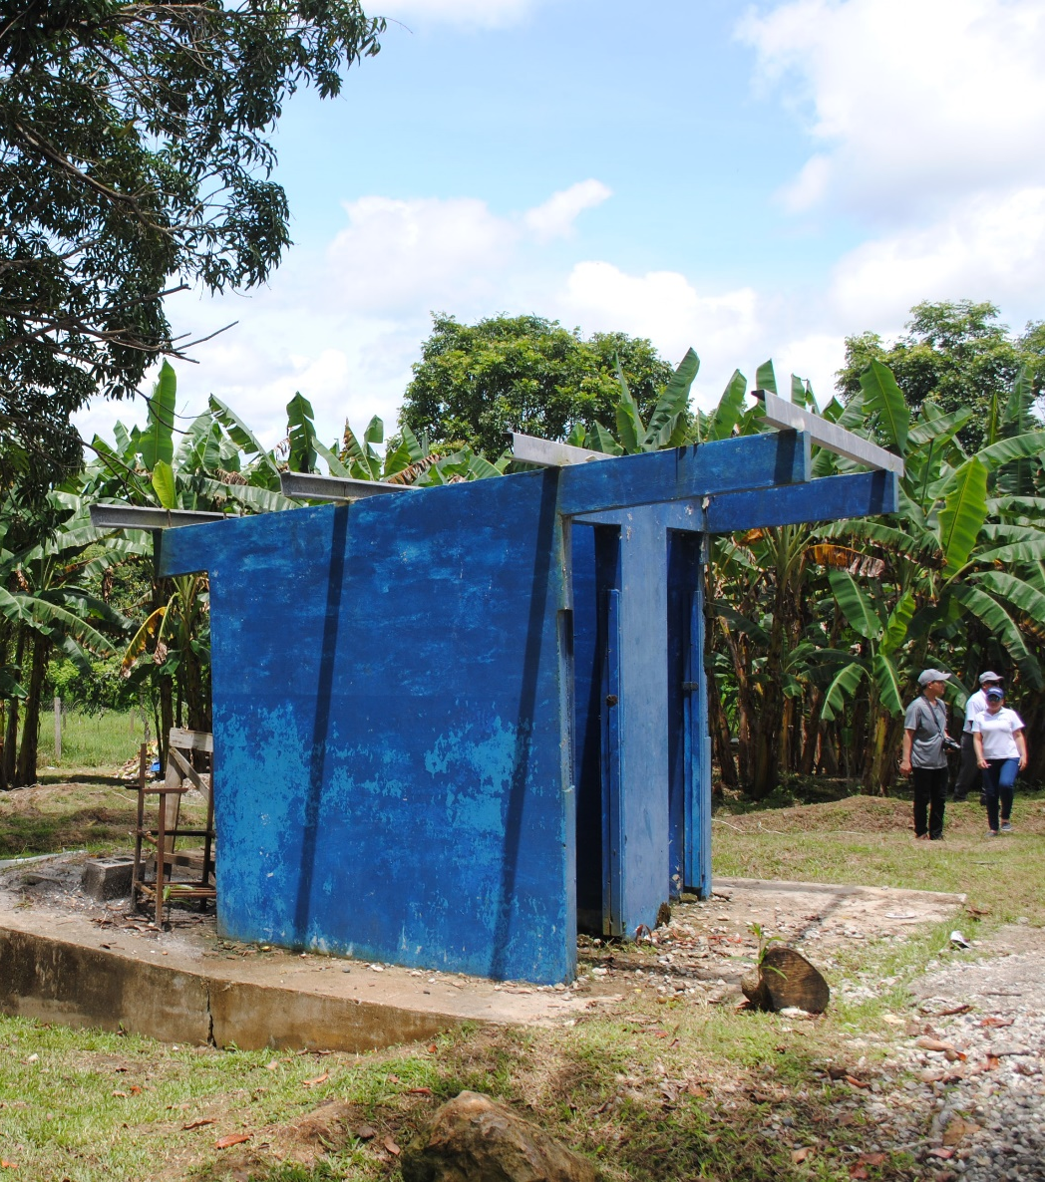
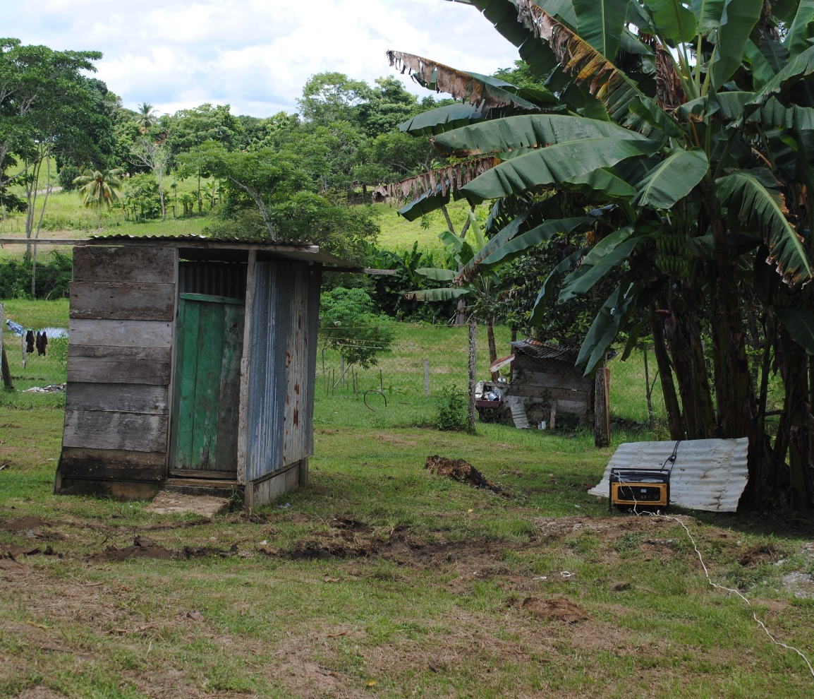
Old Sanitation Facilities at Palmira School
Electrical
Generator

Slide 29
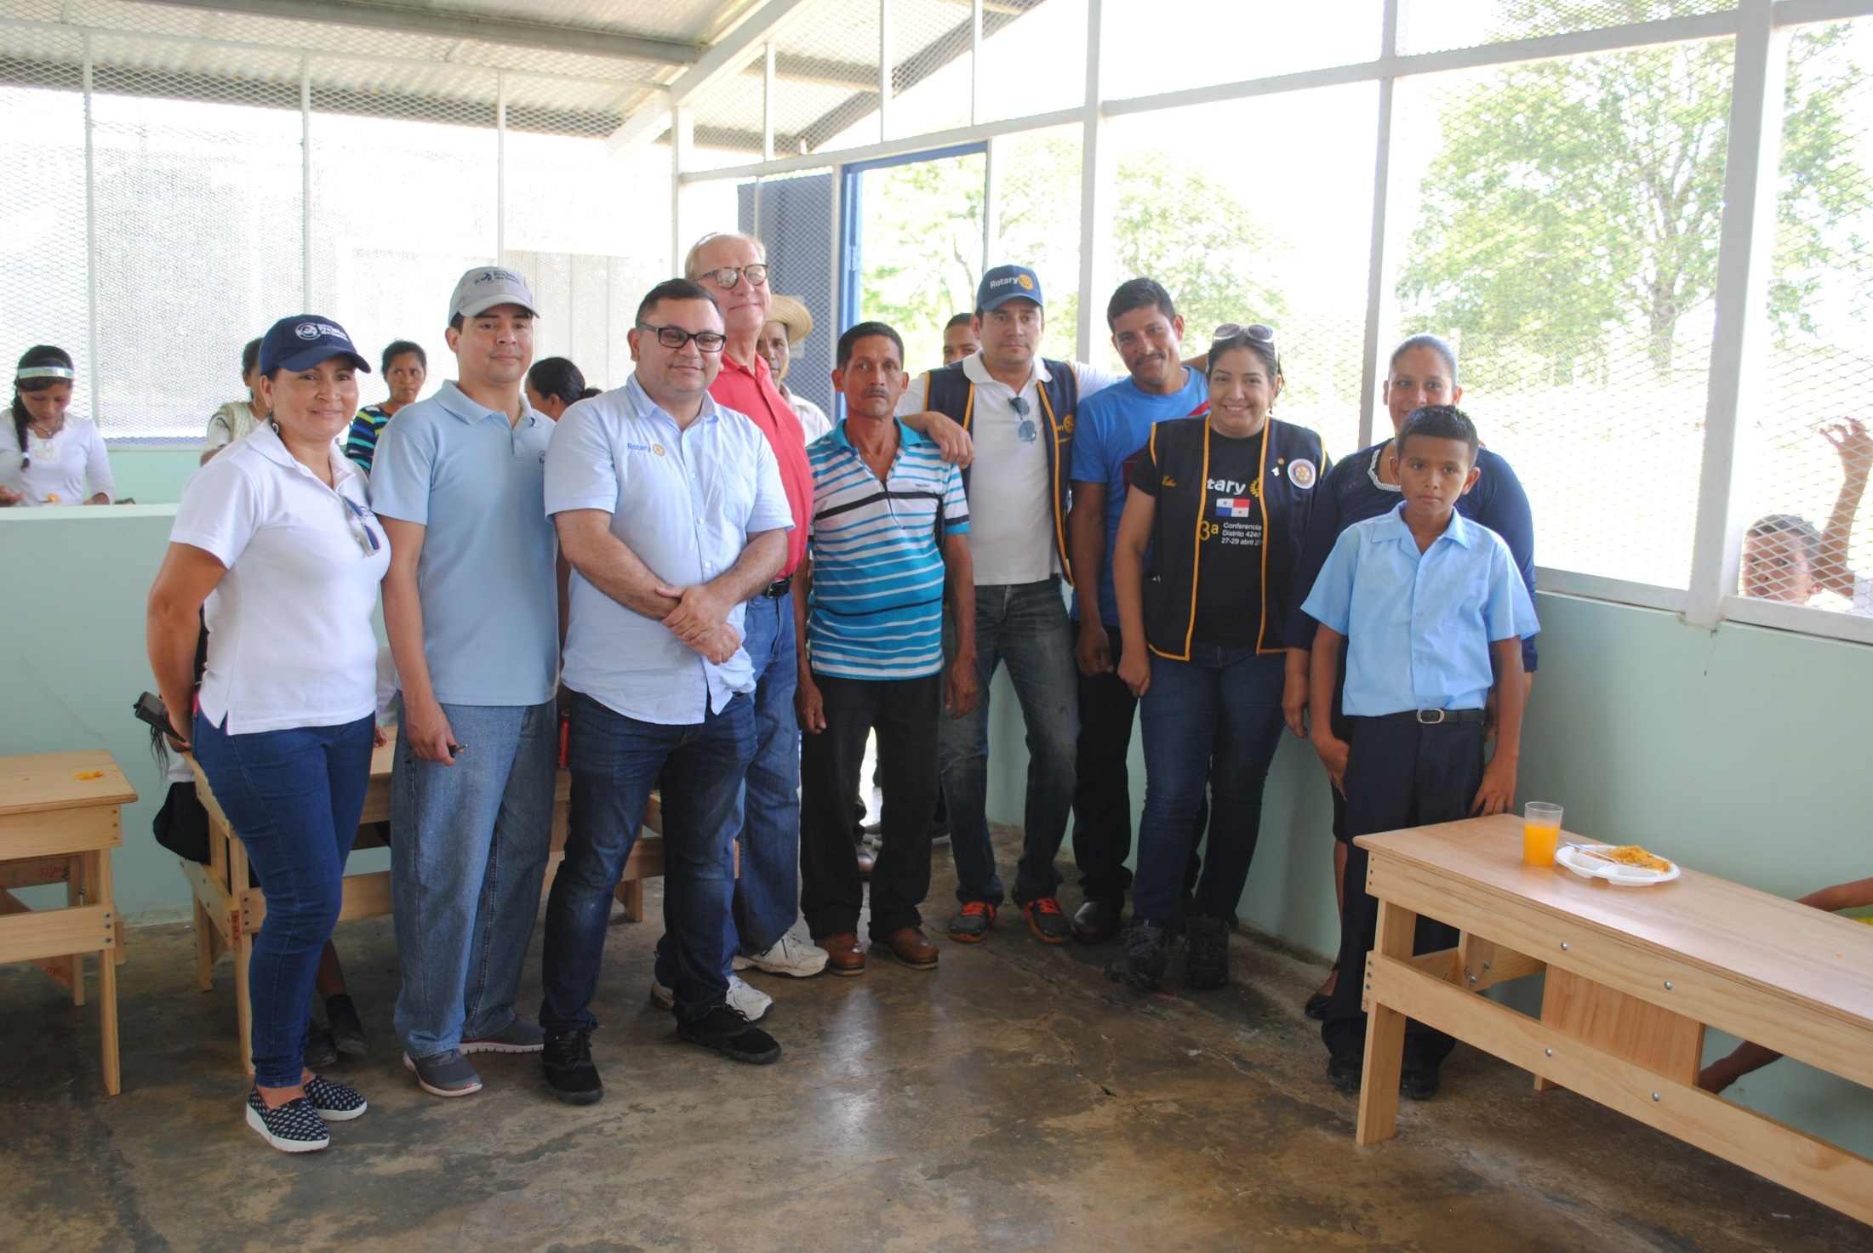
Team Panama with parents and children at Palmira

Slide 31
Viva la Vida!
Team Panama
Fundación Pro Niño’s de Darien
Club Rotario de Panama
Missouri District 6080 Clubs

Slide 33
Global Grant Funding…
District 6080 Club Contributions…$20,370
Rotary Club of Panama City…..…$ 5,000
District 6080 Designated Funds ...$17,500
World Fund Match and RI…….….$28,389*
Total Grant Funding…….$71,259
*cash contributions require a 5% RF administrative cost reduction
Notes:
The contents of this slide is obvious. I would show this to the Warrensburg Noon Rotary Club to show the contribution that the club is making and to illustrate that the PWP 2016 is a cooperative effort between several rotary clubs in Missouri and the Rotary Club of Panama City.

Slide 34
Proposed Budget…
LifeStraw Community Filter Units….$48,686
Water Storage Containers, 5-gal…..$ 8,295
Water Test Kits………………………$ 3,760
Personal Water Bottles……………..$ 765
Replacement and Repair Parts……$ 3,075
Project Outcomes Expenses……....$ 2,138
Price Protection/currency fluc…..…$ 2,138
Total…………………$71,250
Notes:
The contents of this slide is obvious. It show how the grant funds, if approved, might be spent.

Slide 35
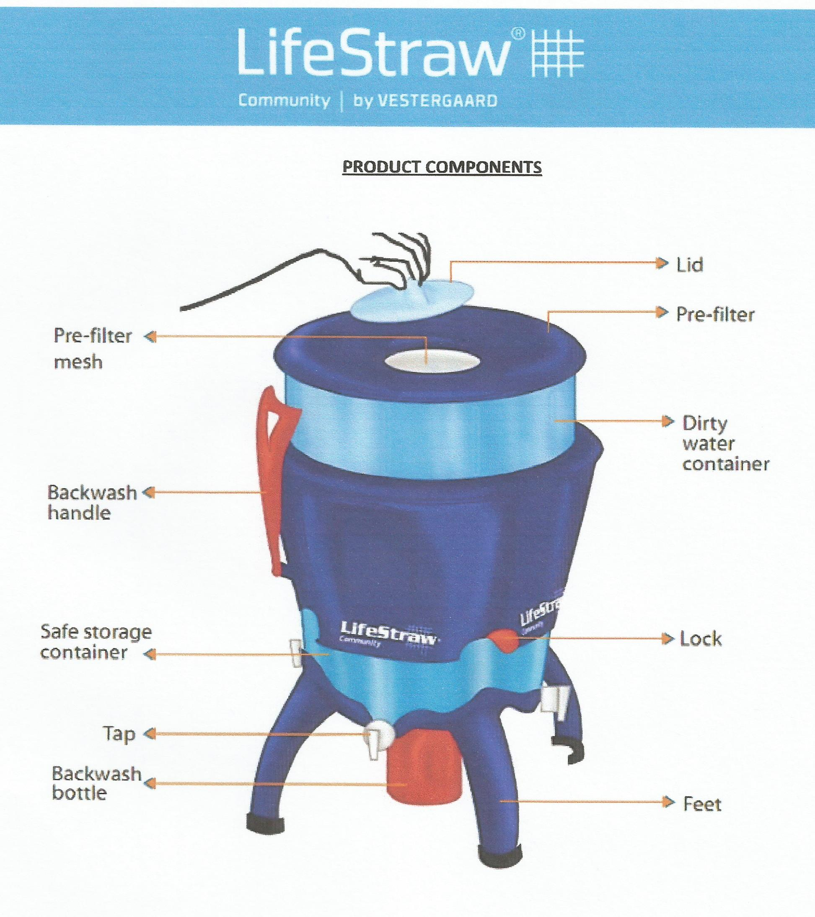
LifeStraw Community
Filtration Unit Stats:
Capacity…
25 L “dirty” water
25 L filtered water
Filtration Rate…
12 L per hour
Filtration Capacity…
> 70,000 L
Approximate Cost…
$300
Notes:
This slide illustrate the LifeStraw Community Filtration System that is proposed for use in the PWP for 2016.

Slide 36
LifeStraw Community
Filtration Unit Efficacy
or “critter” reduction
Efficiency…
Bacteria > 6 log₁₀
Viruses > 5 log₁₀
Protozoan > 4 log₁₀
6 log₁₀ = 99.9999%
Notes:
This slides illustrates why the LifeStraw Community Filtration System was chosen. This system has the efficacy to remove those “critter” that cause stomach and intestinal diseases.

Slide 37
How microfiltration works…
clean water
undesirable
“critters”
“dirty water”
0.02 micron pore
0.02 microns = 0.02 micrometers = 0.0000008 inches
Notes:
This slide illustrates how the LifeStraw hollow fiber microfiltration system works. The filter, consisting of hundreds of hollow fiber membranes, is submersed in unfiltered water. Relatively large items, like bacteria, viruses and protozoan, cannot pass through the pores in the membrane. Water molecules can pass through the membrane and travel through the hollow fibers to be collected and consumed. Contaminant smaller than 0.02 microns can pass through the membrane and would still be in the filtered water. Common examples would be metal and non-metal ions like lead, chromium, arsenic, etc.

