Slide 1
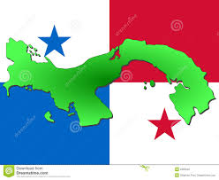
Service Above Self
Joint RD 6080 and 4240 and
Fundación Pro Niño's de Darién
Panama Water Project - 2017
RF Global Grant
and beyond…

Slide 2
The Fundación Pro Niño's de Darien (FPND) is a non-profit organization in Darien Provence, Panama, whose primary mission is to reduce child malnutrition through interrelated activities: nutrition, health, education, early childhood development, farming production and community development.
The lack of clean, potable water in schools, nutrition sites, and communities-at-large, requires nearly all residents to drink untreated water obtained directly from a near-by river.
Notes:
This slide introduces the Foundation for the Children of Darien, its mission, and why a water filtration project is Darien is important.

Slide 3
The Fundación Pro Niños de Darién (FPND) has identified 26 communities in Darien as points of focus for the Panamanian Water Project (PWP).
These communities are designated as nutrition sites and there is a school present at each site with a combined school population of about 1800.
These 26 communities have a total population of 7200, hence, 7200 secondary beneficiaries.
Notes:
This slide shows some specifics of the PWP 2016. The slide illustrates that a large number of people are to be impacted by the project.

Slide 4
Morti (25)
Zimba
17-18
19-24
2,4-7,9
12-16
1,3,8,10,11,26
Sambu River
Approximate location of 26 Darien
Schools and Communities
Notes:
This slide shows the location of the 26 nutrition sites involved in the PWP 2016.

Slide 5
Meteti
Alto Playona
Approximate location of Alto Playona w.r.t.
Meteti

Slide 6
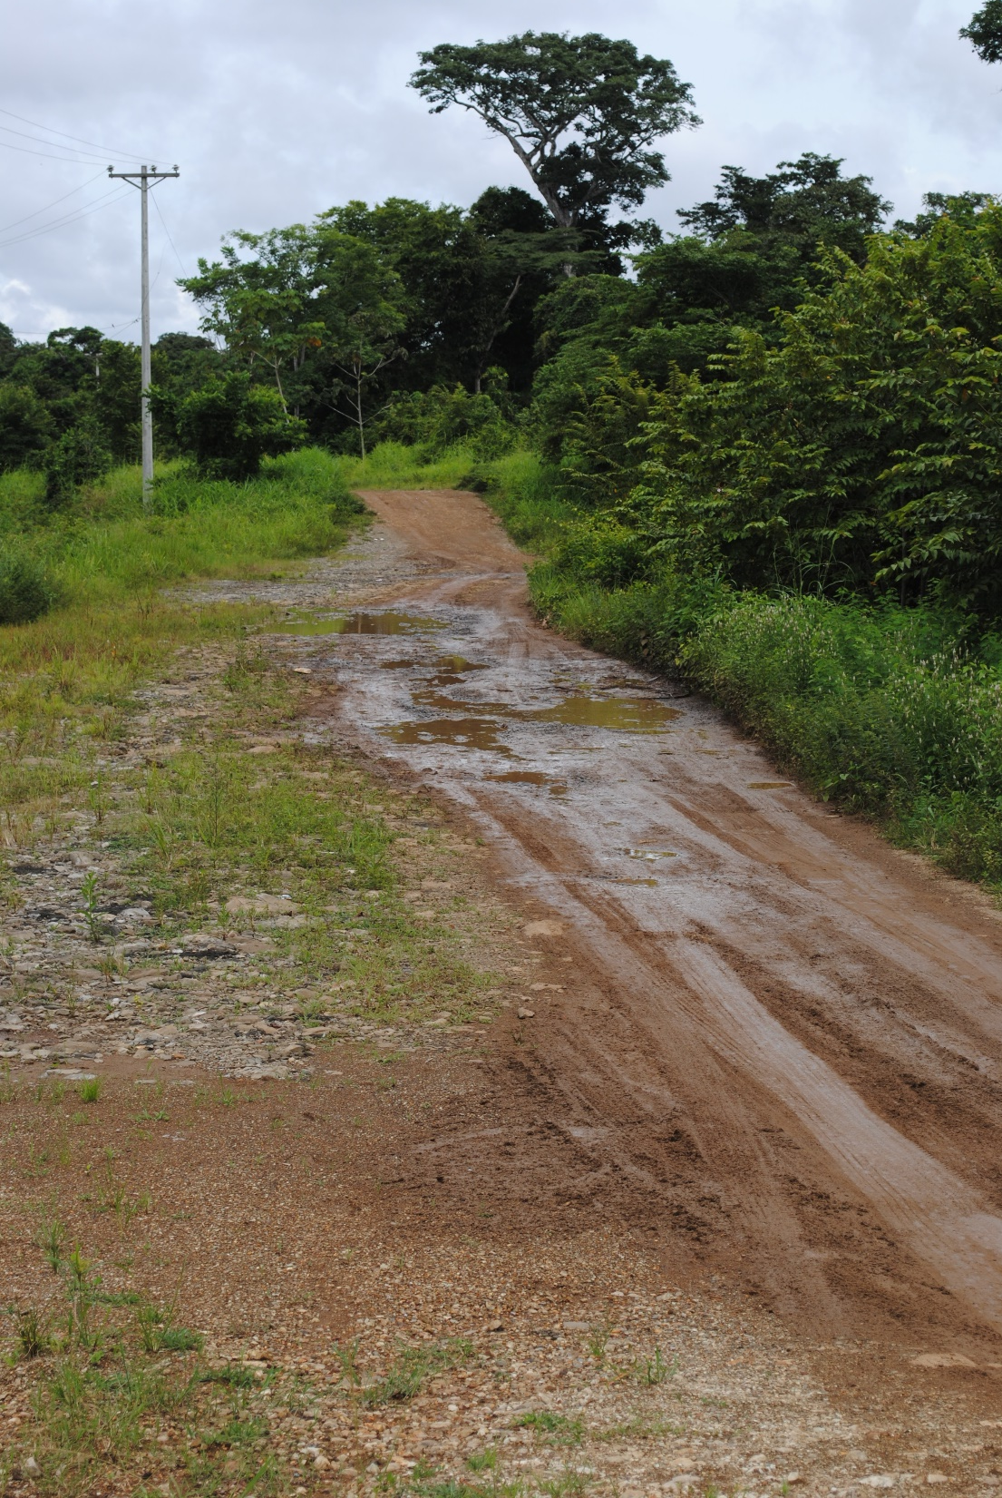
Road to the
Chucunaque
River

Slide 7
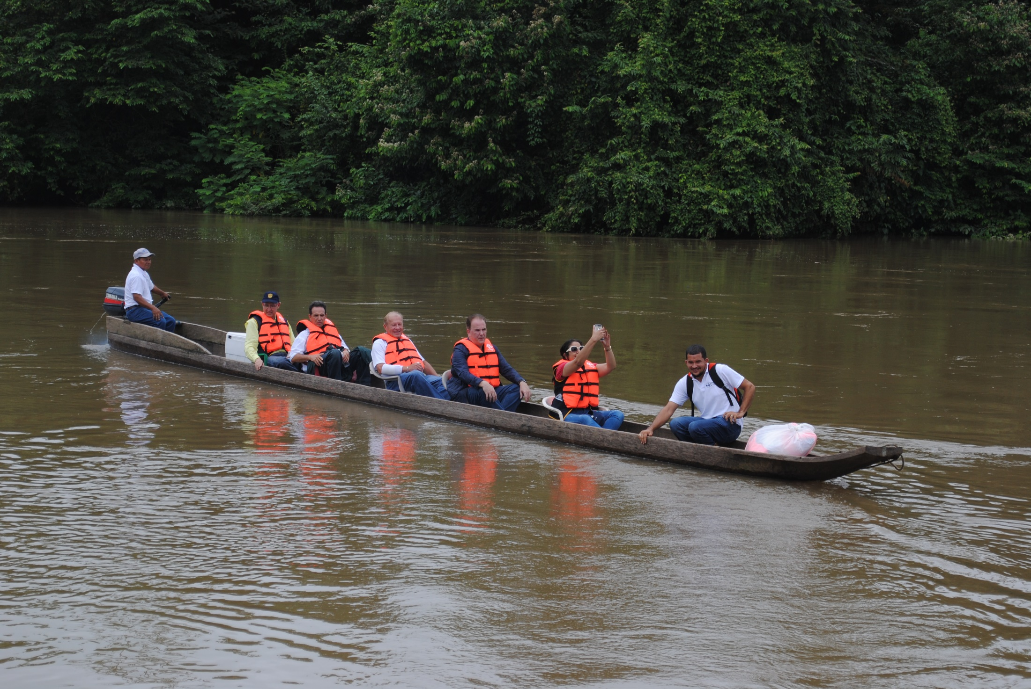
River Transportation on the Rio Chucunaque

Slide 8
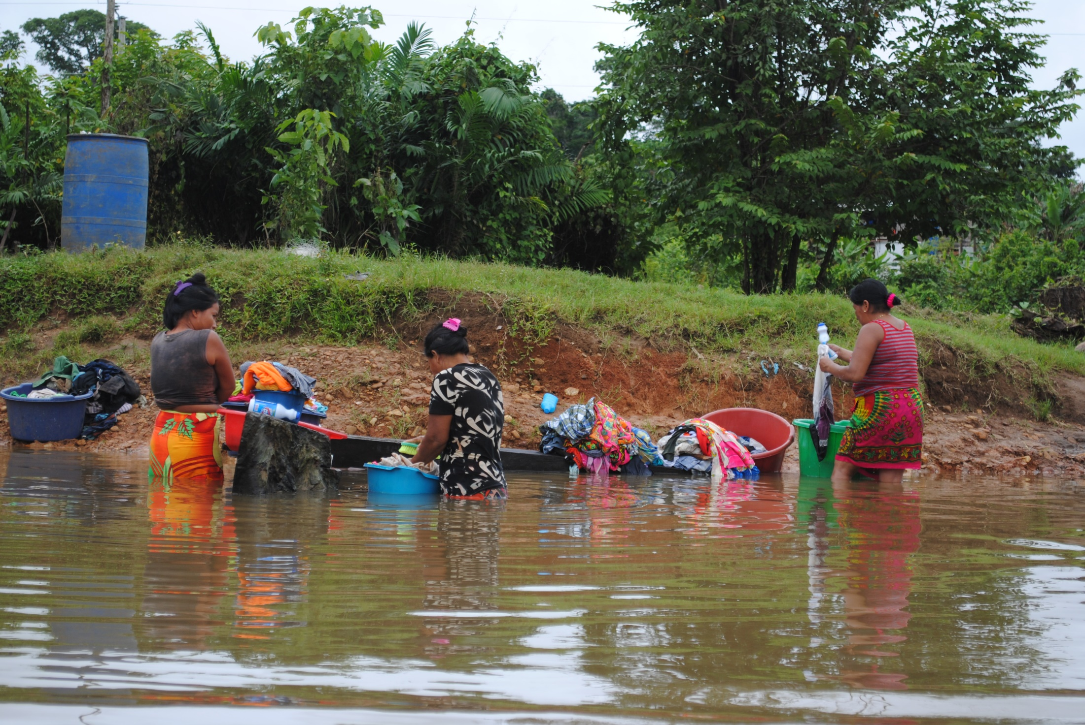
Wash Day at Alto Playona

Slide 9
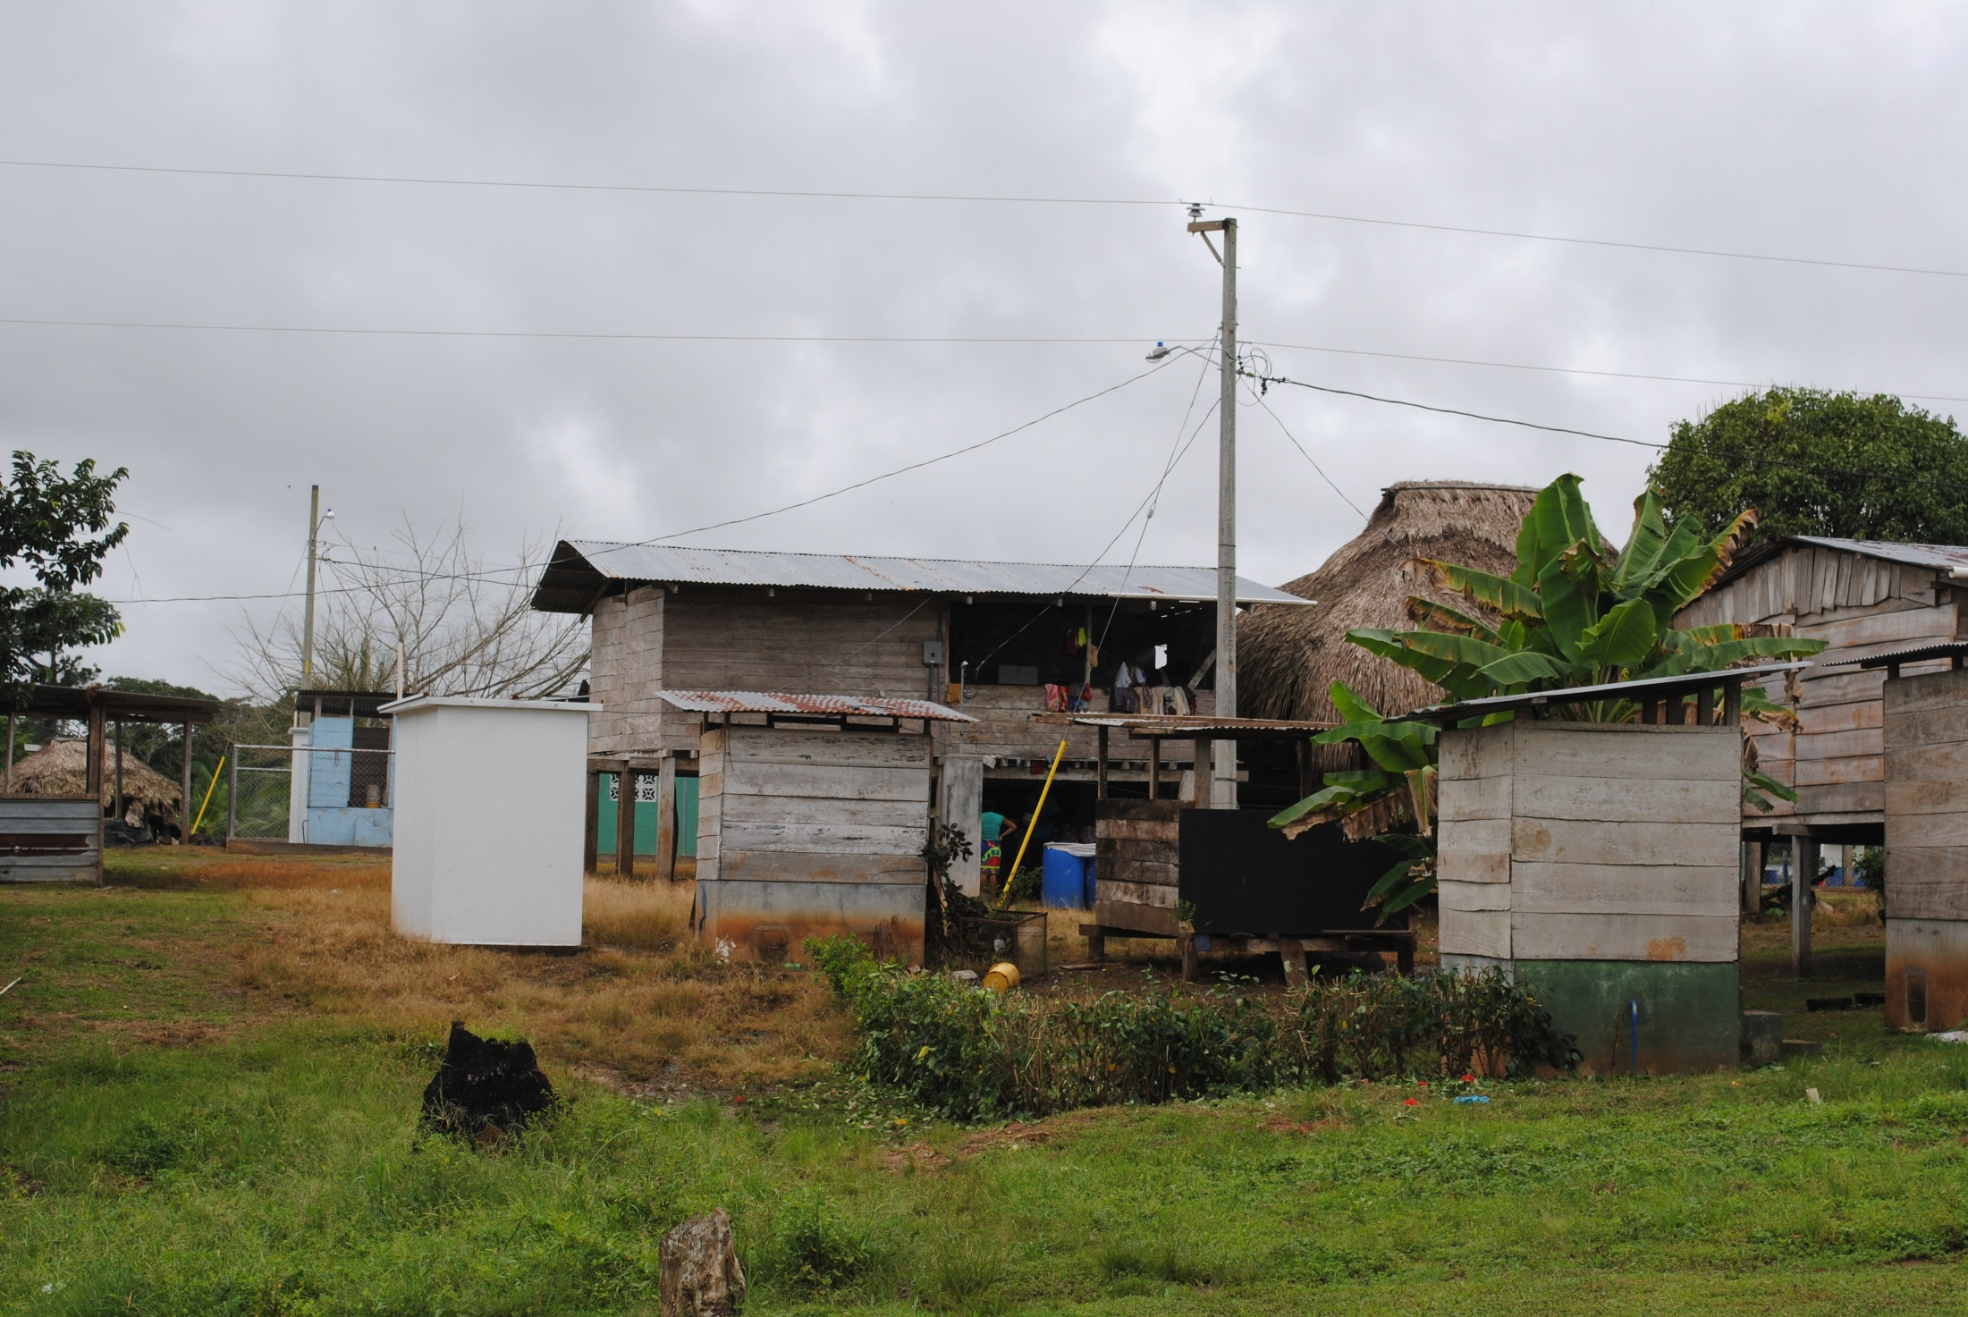
The new and the old at Alto Playona

Slide 10
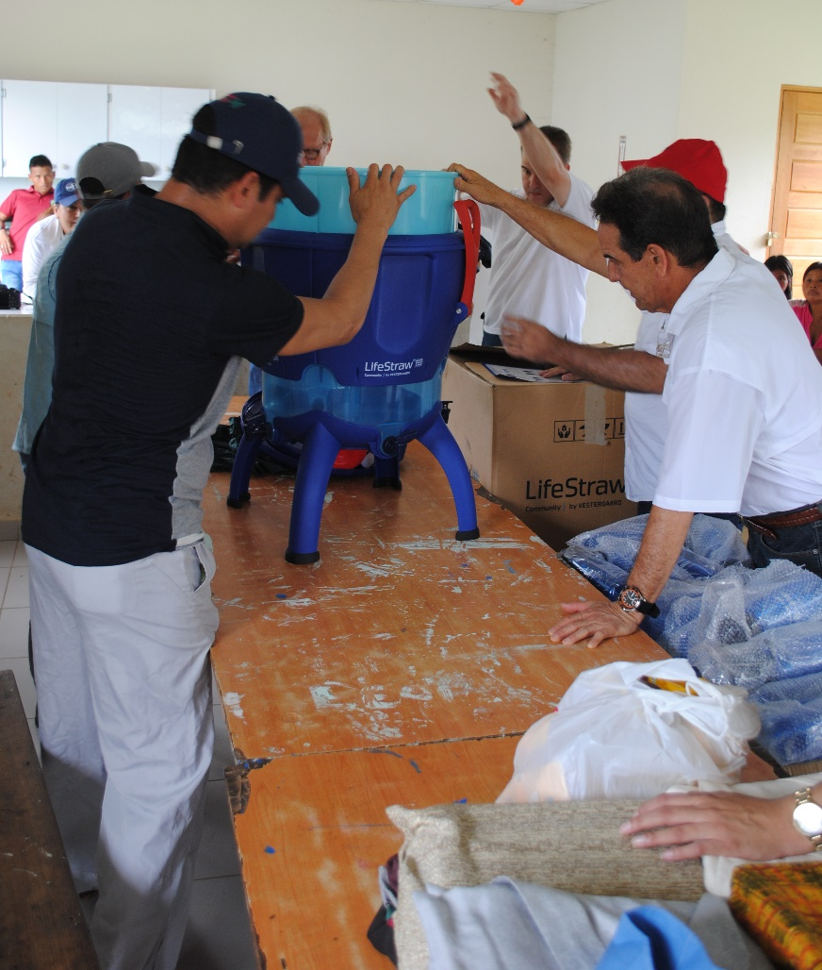
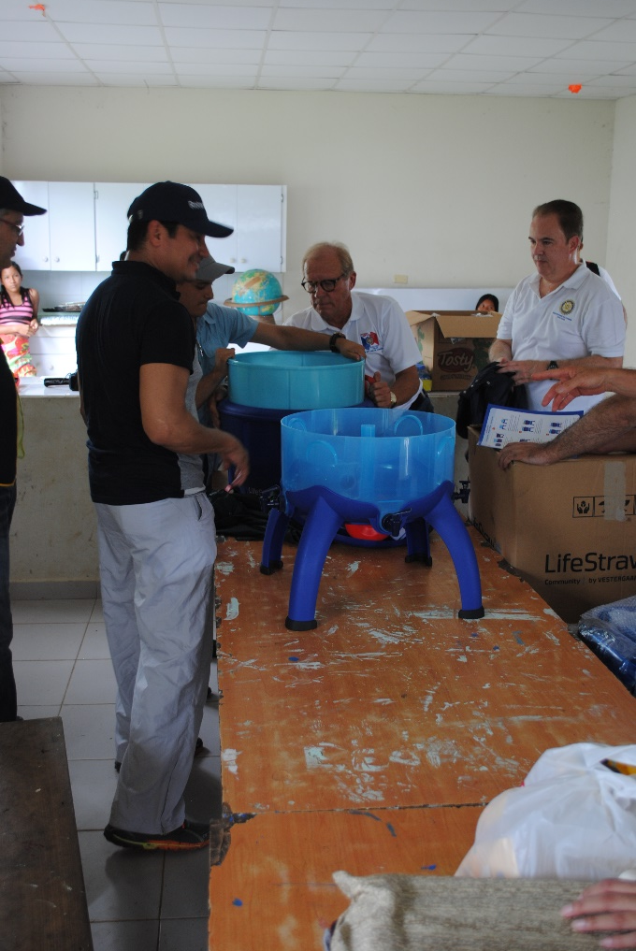
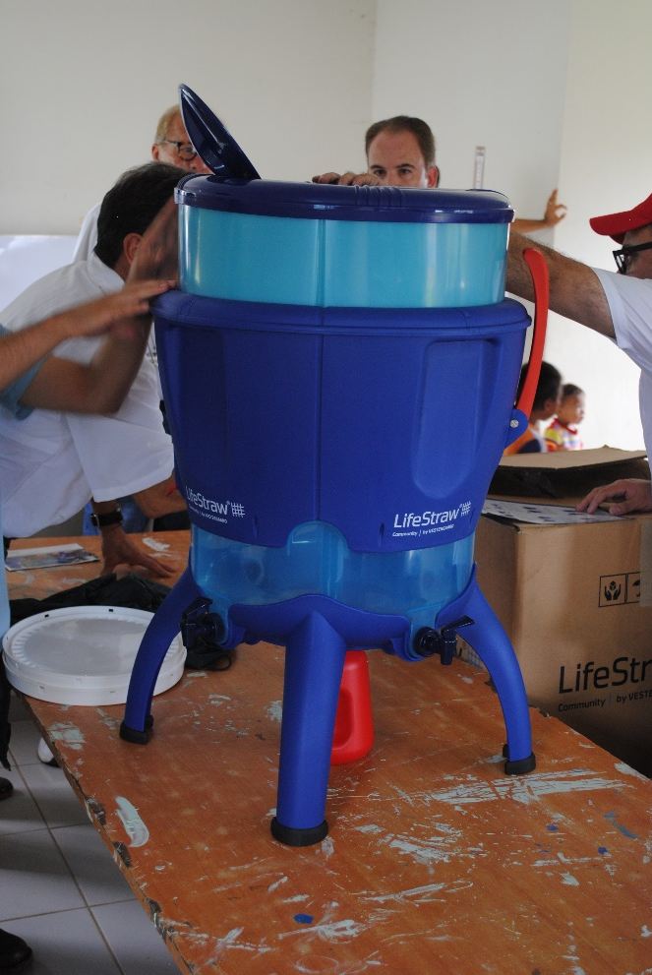
LifeStraw Community
Filtration Unit (LCFU)
assembly at Alto Playona

Slide 11
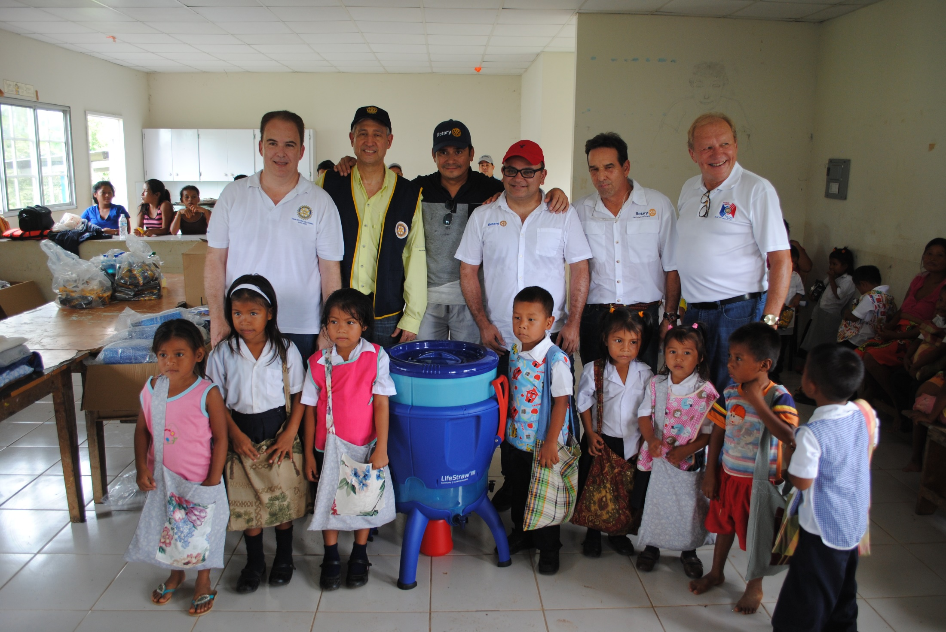
Team Panama with school children of Alto Playona

Slide 12
Palmira
Meteti
Approximate location of Plamira w.r.t.
Meteti
Notes:
This slide shows the location of one of the 26 nutrition sites involved in the PWP 2016 and the fact that it is accessed via the Sambu River.

Slide 13
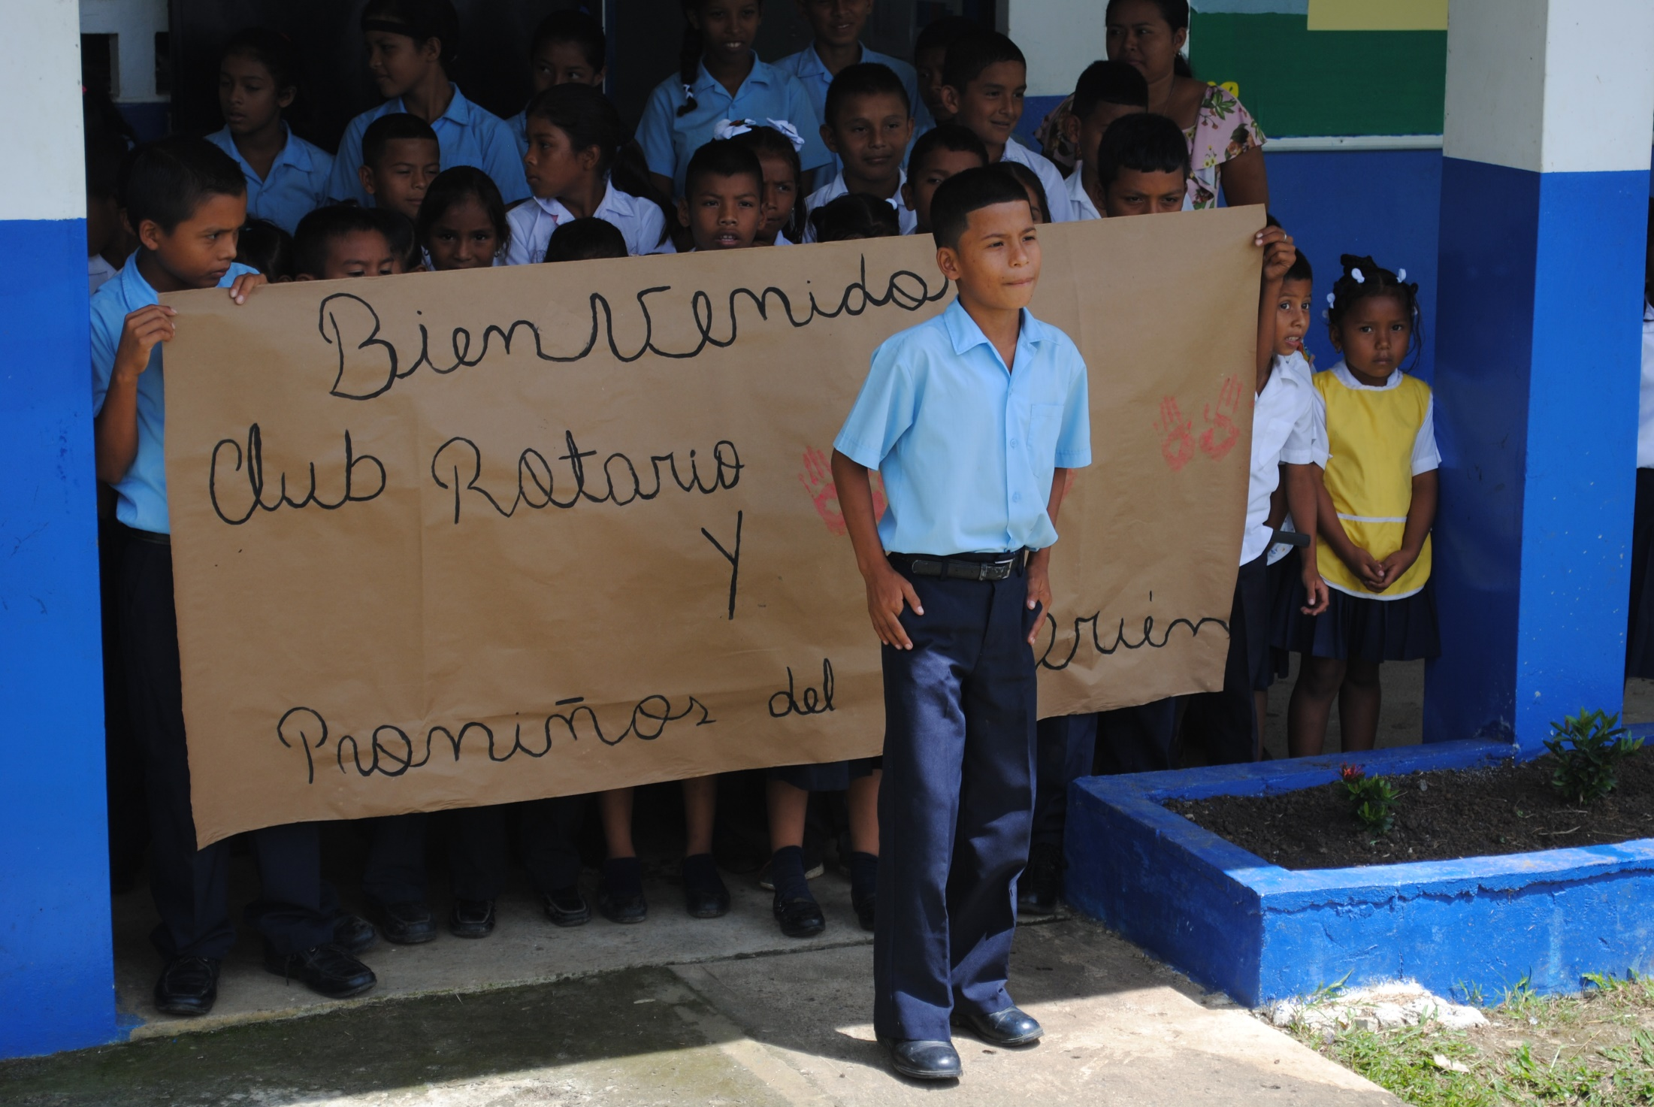
Students welcome Team
Panama to Palmira

Slide 14
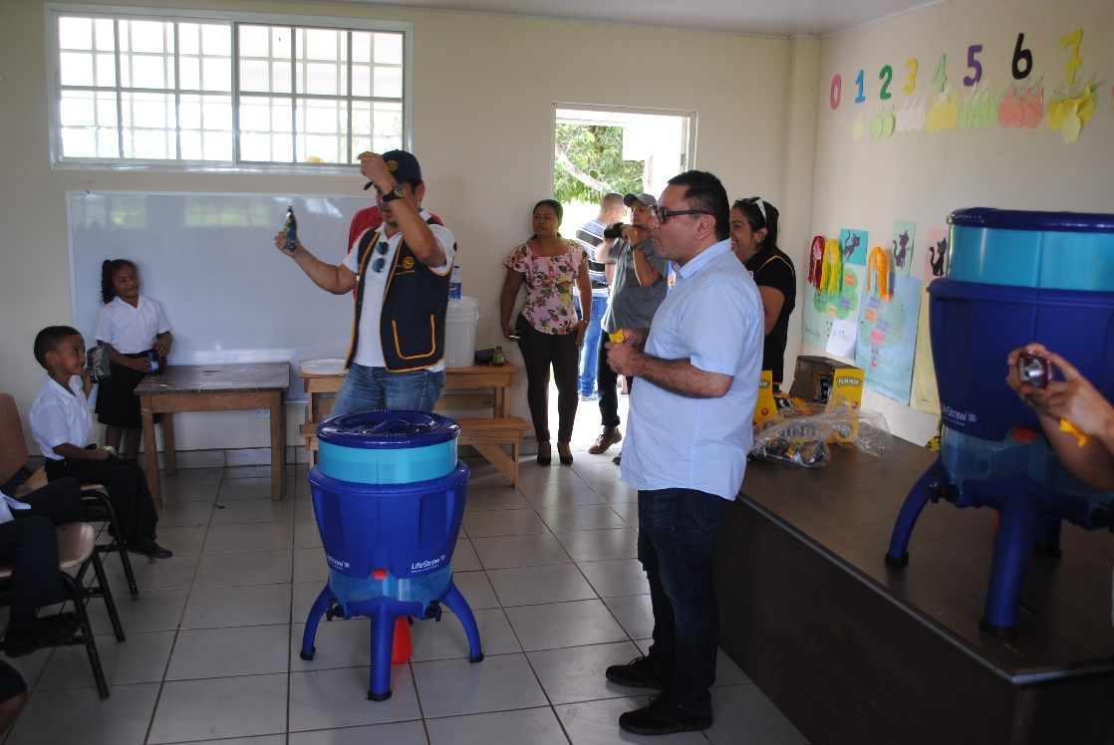
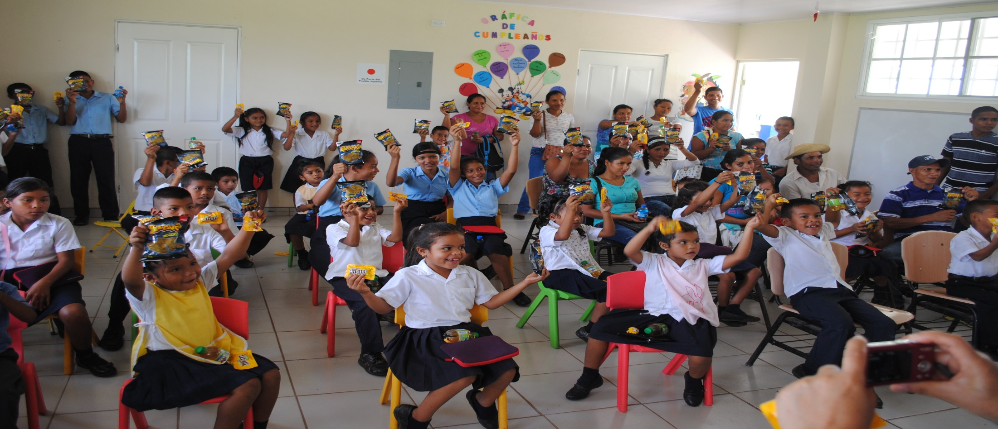
LCFU Assembly and Training at Palmira School

Slide 15
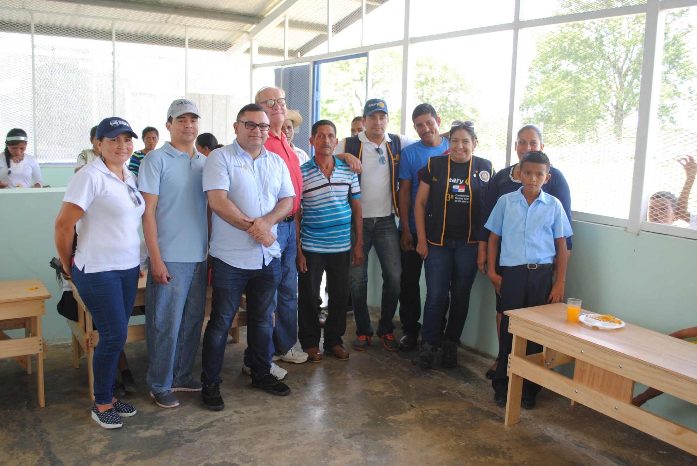
Team Panama with parents and children at Palmira

Slide 16
Service Above Self
Thank you District 6080.
We could not have done it without you!
The people of Panama thank you.

